Slide 1
Amtrak Public Health
Keeping Public Health on the Right Track
Maxine Linthicum Davis, CP-FS

Slide 2
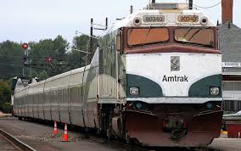
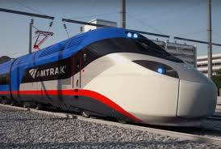
History – Inauguration
1971 – National Railroad Passenger Corporation (Amtrak) is established to provide intercity passenger travel throughout the US and some Canadian Provinces.
The name “Amtrak” came from a combination of “American” and “Track”.
Congress passed the Rail Passenger Service Act to revive passenger rail service.
Amtrak is a for-profit corporation that receives federal and state funding.

Slide 3
Company Overview
Boards over 30 million passengers annually
Serves over 500 destinations in 46 states, the District of Columbia and 3 Canadian provinces (~3.2 million riders in Chicago)
Earned approximately $193.7 million in revenue for 2017
Ticket revenue and state contracts make-up 94% of operating costs
Amtrak owns operating infrastructure in the Northeast Corridor and parts of Michigan
All other service relies on host railroad infrastructure

Slide 4
System Map

Slide 5
Amtrak Public Health Mission
To provide guidance for continuous improvement of Amtrak’s sanitation standards. This effort provides passengers and employees the highest quality of sanitation possible and promotes a greener, healthier environment on Amtrak trains, stations and facilities. This is accomplished by partnering with Amtrak departments and Federal Regulatory agencies.

Slide 6
Amtrak Public Health
Reports to the Vice President of Safety, Health & Environmental
Staff of 5 inspectors/auditors covering entire network
1 Director
1 Manager
1 Administrator
1 Senior Analyst (Inspector/Auditor)
4 Senior Public Health Specialists (Inspectors/Auditors)
Amtrak Medical Director available for technical guidance

Slide 7
Public Health Structure
Executive Vice President of Safety, Health & Environmental (CSO)
AVP Health Environment & Sustainability
Senior Manager Public Health
Senior Public Health Analyst (New York)
Senior Public Health Specialist (Washington)
Senior Public Health Specialist (Chicago)
Senior Public Health Specialist (Chicago)
Senior Public Health Specialist (Los Angeles)
Senior Public Health Specialist (Oakland) Vacant
Administrative Chief

Slide 8
Public Health Specialist Regions

Slide 9
Purpose of Amtrak Public Health Department
Monitor Federal Regulatory Standards issued by U.S. Public Health Service (PHS) Act:
Interstate Travel Program (ITP) regulated by U.S. Food & Drug Administration (FDA)
Safe Drinking Water Act (SDWA) regulated by U.S. Environmental Protection Agency (EPA)
Recently, FDA Food Safety Modernization Act (FSMA) regulated by FDA to implement preventive measures of eliminating foodborne illnesses (FBIs).
Conduct Public Health Inspections, Audits, Surveys, and FBI Investigations on Rolling Stock & Amtrak Facilities.

Slide 10
Interstate Travel Program (ITP)
Administered by the FDA
Allows random, unannounced inspections of foodservice cars, commissaries, food vendors, and watering facilities
Several regulatory guidelines; not just current FDA Food Code
21 CFR
FDA Handbook on Sanitation of Railroad Passenger Cars
FDA Guide to Inspections of Interstate Carriers and Support Facilities.
FDA Handbook for Railroad Service Areas
Violations can stop passenger train service
Amtrak railcars entering Canada are randomly inspected by Public Health Agency of Canada

Slide 11
Interstate Carrier Conveyance Program
Administered by USEPA as part of the SDWA & NPDWR
Requires all passenger conveyance compliance (Railroad, Watercraft, Bus & Aircraft)
Water samples required every 3-years (Total Coliform, E.coli)
Significant penalties for non-compliance
Requires routine drain & fill and disinfect & flush maintenance (60/90/120 days)

Slide 12
Inspections and Programs
Inspections of:
Trains – diners, café’s, parlor cars, sleepers and coaches
Potable water facilities & laboratory sampling
Commissaries – (Aramark – contracted services)
Food Vendors
Restrooms
Public Health Related Mechanical Defects
Customer Complaints: FBIs
Integrated Pest Management (Nuisance Abatement)

Slide 13
Trains
On Board Services are responsible for maintaining FDA Food Code Regulations and the safe and pleasant preparation and presentation of food to our customers
Chefs and food specialist prepare the food in dining cars
Service Attendants take orders and deliver the food
All food workers are responsible for food safety
Temperature monitoring
Dishwashing-sanitization verification through thermolabels
Proper thawing of foods
Proper preparation of food
A pre-departure checklist to helps to ensure compliance

Slide 14
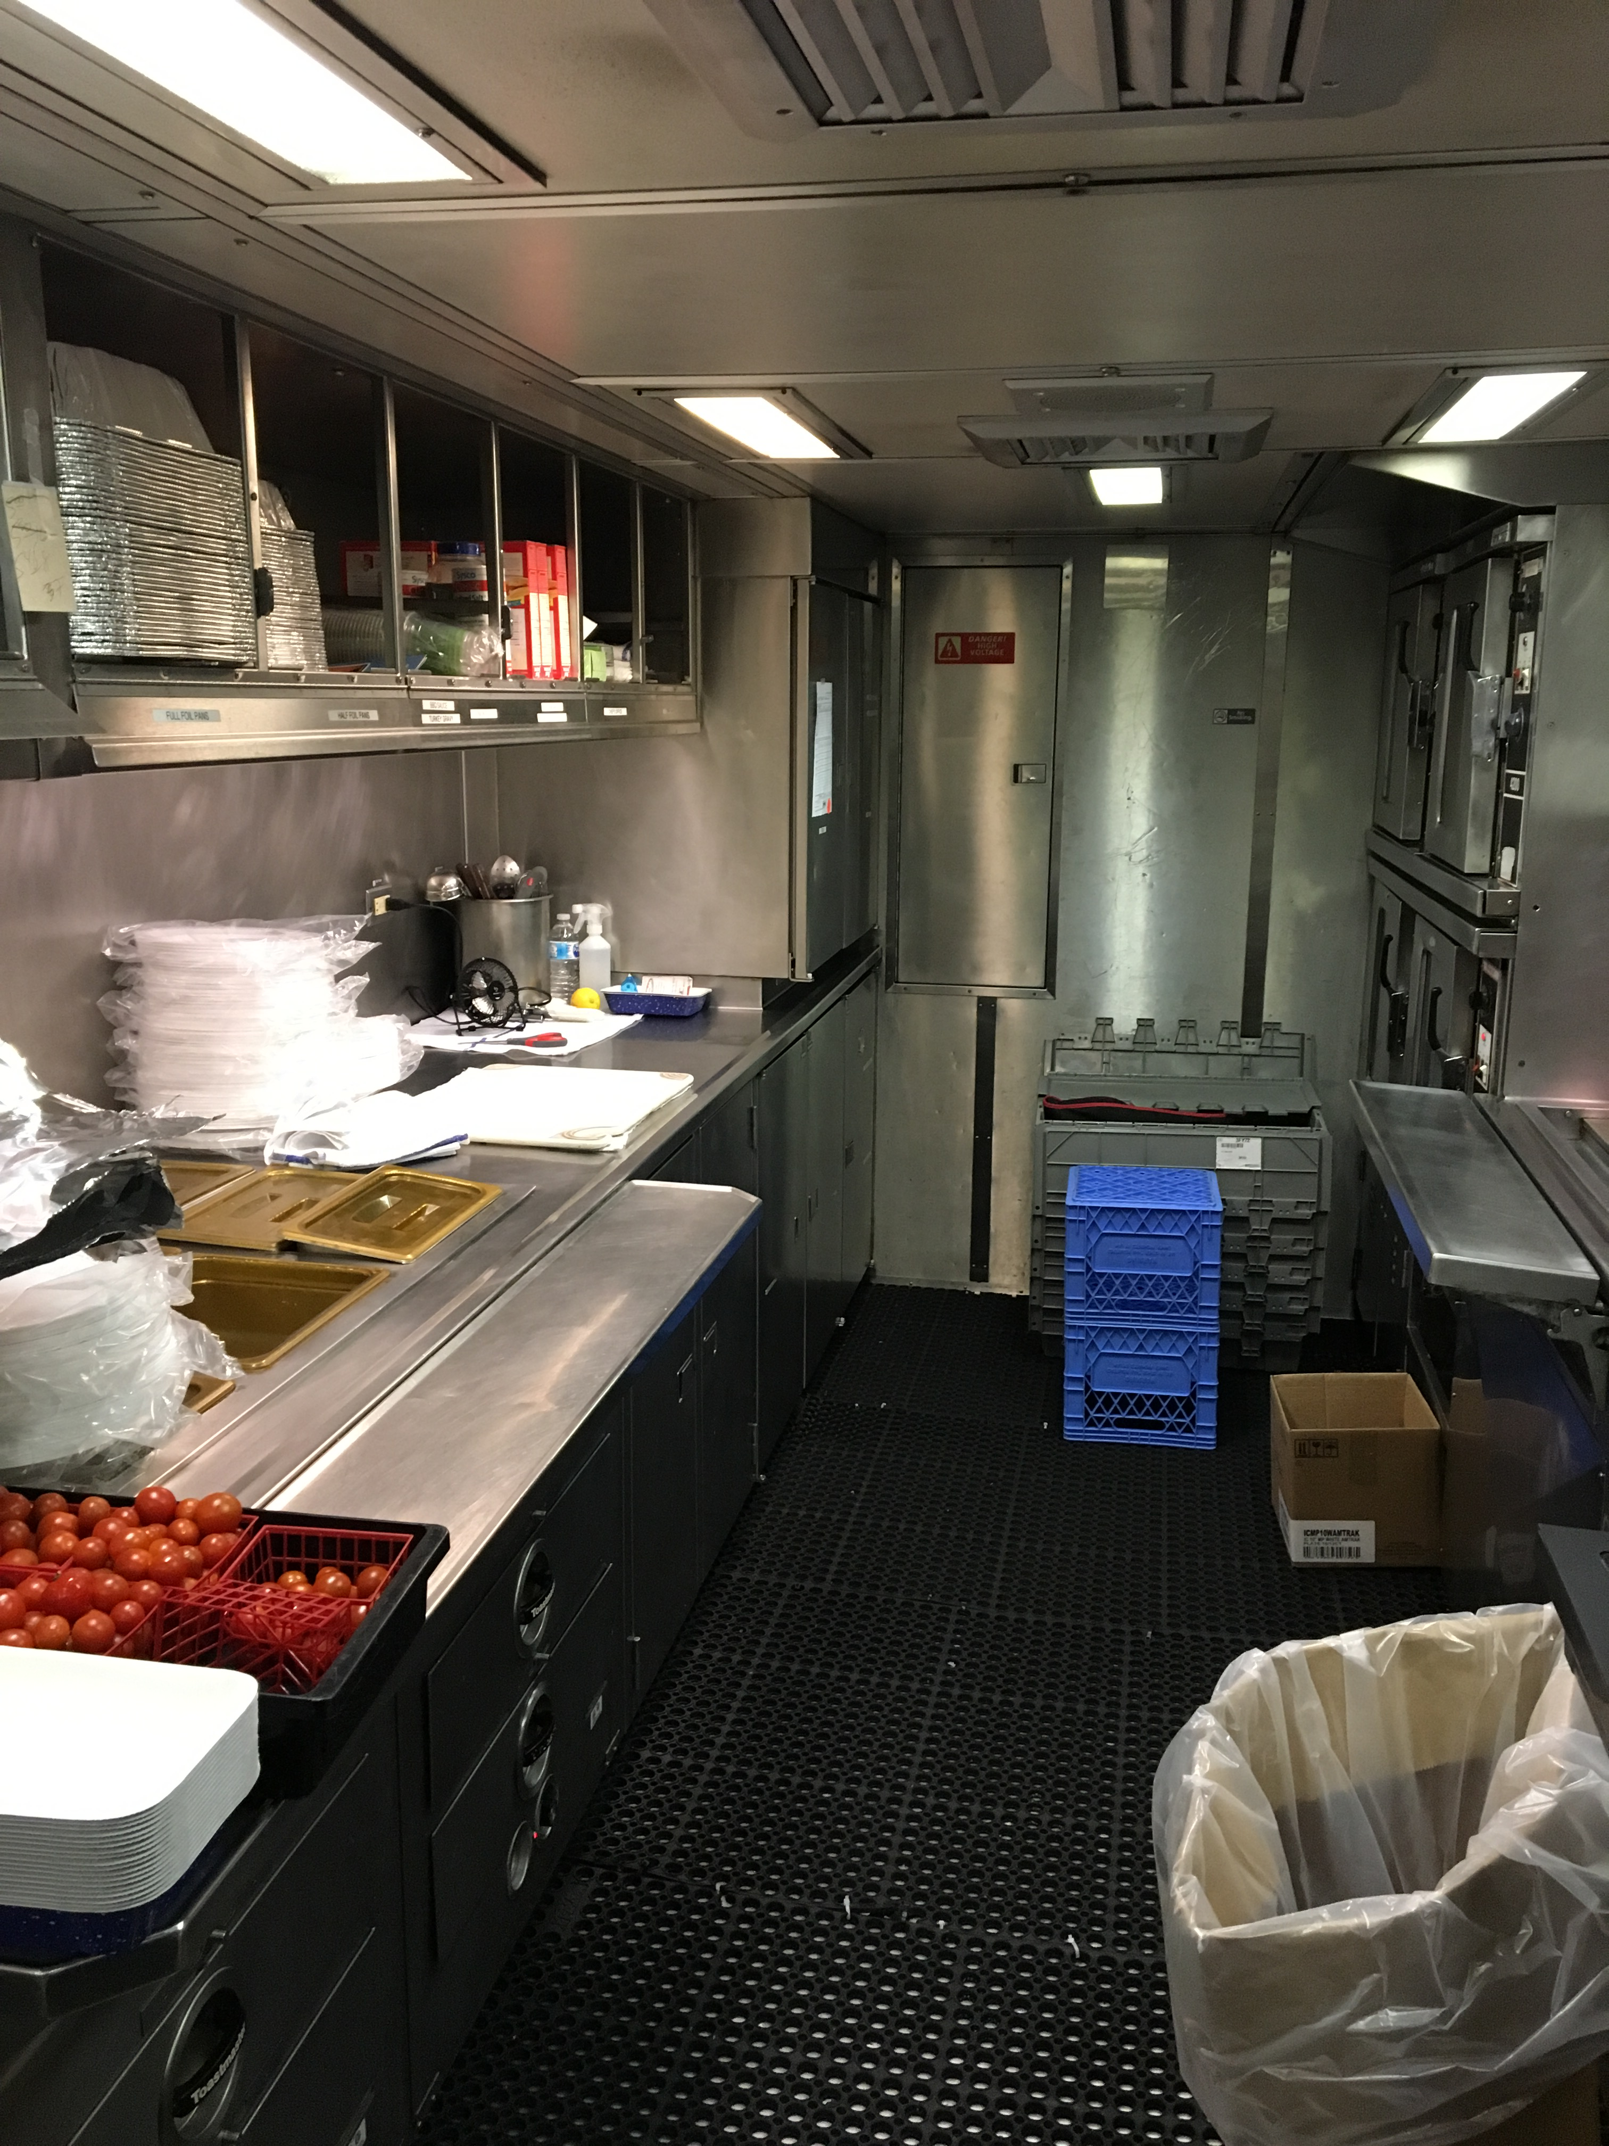
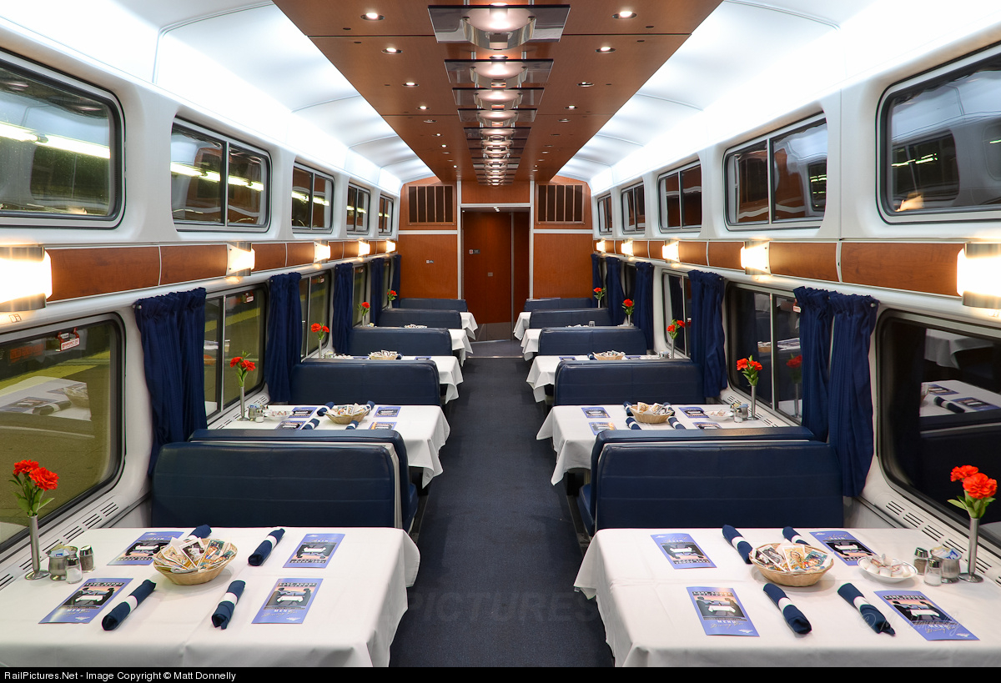
Dining Car
Provides a full-service dining option for passengers
Product is generally sous-vide and heated to specified temperature for service
No complex preparation

Slide 15
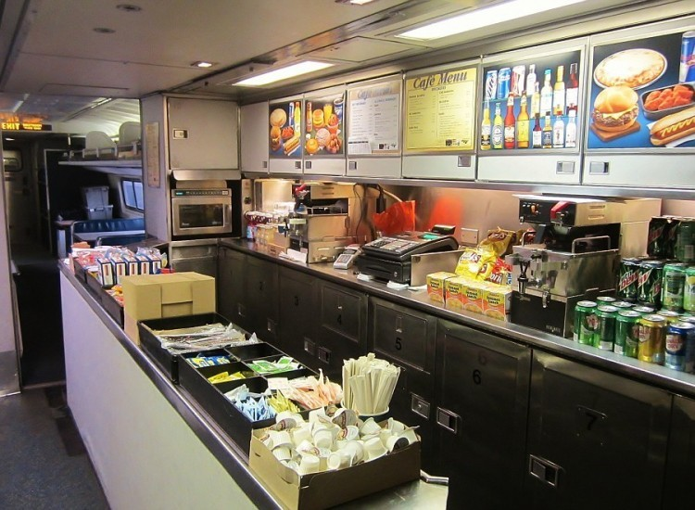
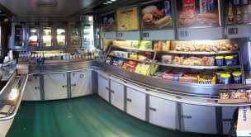
Lounge/Café Car
Provides quick service “snack” options for passengers
Products include RTE and microwaveable foods
One Lead Service Attendant (LSA) runs operation

Slide 16
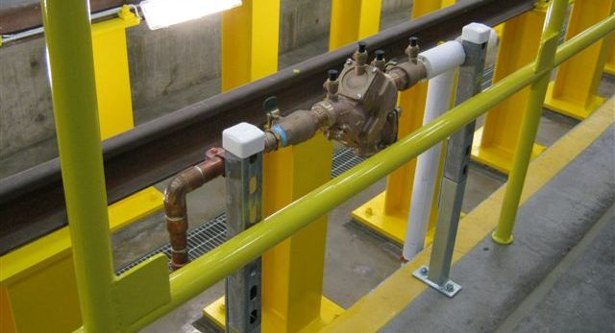
Water Points
Water is provided to trains at approved station and yard water points
Personnel that are involved in watering the trains must take a watering course
A few of our watering points are maintained and administered by contracting companies
Amtrak Public Health ensures compliance with FDA and EPA standards by conducting routine inspections

Slide 17
Food & Beverage Warehouse Operations (Commissaries)
Amtrak maintains 12 major commissaries throughout the United States
Aramark is contracted to manage our commissaries
Amtrak Public Health is required to inspect all commissaries once a month or quarter (depending on location)
Each commissary has an Amtrak Food and Beverage Manager that administers the contract with the Aramark manager
The Commissary workers package and deliver food, ice, silverware, and plates to our trains
A temperature monitoring program is in place to ensure the integrity of the food delivered to train

Slide 18
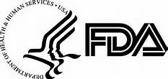
Vendor Inspections
Typically vendors are pre-approved by Amtrak Public Health and subsequently inspected by the FDA, Amtrak Public Health, and Local Health Departments routinely
All vendors are approved by Amtrak Public Health
Vendors that make label food for Amtrak are pre-approved
Vendors already FDA or USDA approved, provide food in commercial packaging and are pre-approved

Slide 19
Inspection Summary:
Annual Public Health Statistics:
120 Commissary Inspections
261 Diner Car Inspections
597 Lounge Car Inspections
84 Water Point Inspections
15 Vendor Inspections
Compliance Challenges

Slide 20
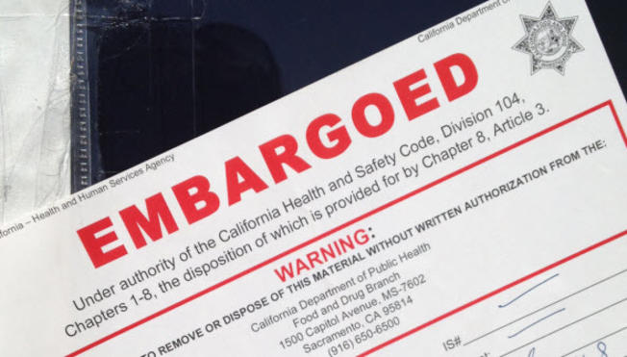
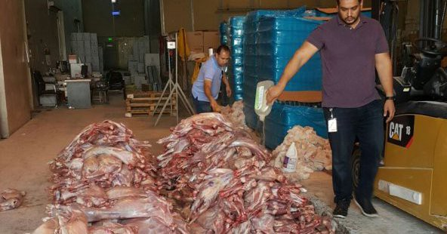
Dealing with Compliance Challenges
We implement corrective actions when major issues exist or recur.
Corrective Actions consist of pulling car sets, cancelling service, and/or confiscate food.
We also conduct extensive food safety training with On-board Services and mechanical employees of FDA and EPA updates.

Slide 21
Future Prospective in Meeting Compliance
Technological Advancement of Monitoring Systems
Temperature Control, Product Inventory/Tracing/Recalls, & POS Systems
Creating Standardization Programs for Training
Train & Mechanical Employee Training systems & Public Health Training systems
Remediation Programs for Recurring Issues
Corrective Action Programs, Incentive Programs & Disciplinary Actions

Slide 22
Mechanical Operations
Amtrak’s Mechanical Department supports public health priorities
Routine cleaning of cars occurs in the PM facilities as well as a 92/120 day scheduled overhaul (aka- extreme cleaning) cleaning
All cars, including foodservice are overhauled every 4 years
The EPA Order of Consent has required Amtrak to sample every water tank on each car for coliform and E. Coli (same program as airlines)
Pipe Fitters and other mechanical workers have been trained to properly collect, preserve, and ship samples to an approved EPA lab

Slide 23
Customer Concerns
Although infrequent, customers may voice concerns regarding sanitation
Public Health investigates all cases of suspected food borne illness
Communicable disease investigations are rare and are conducted with the direct involvement of Amtrak Public Health and Amtrak’s Medical Director who coordinates with CDC
Amtrak contracts with Copesan to provide Pest Service (IPM) to all trains, commissaries and facilities. Amtrak’s Public Health Director is directly involved with all coordination and notifications.
Passenger injury investigations are sometimes conducted in conjunction with claims

Slide 24
Interdepartmental Support
Public Health
Conductors
On Board Service
Station Managers
Mechanical
Engineering
Environmental (Industrial Hygiene, and Safety)
Operations

Slide 25
Take the Train! www.Amtrak.com
Experience the beautiful views, meet interesting people, and enjoy wine and cheese on the Coast Starlight!
Shower and brush your teeth with clean water. Fresh towels and sheets are provided in sleeping accommodations
https://www.youtube.com/watch?v=9Zm8xRhaHdo
Leave the driving to Amtrak - sit back and relax
By taking this mode of transportation you’re helping the environment by diminishing your carbon foot print!
All aboard!

Slide 26
Questions?

