Slide 1
Investigation of a Salmonellosis Outbreak Linked to Raw Beef Consumption – Virginia, 2023
NCAEHA 2024 Winter Educational Conference
Sahill Patel, MPH
CD Program Epidemiologist
Arlington County Public Health Division
January 31, 2024

Slide 2
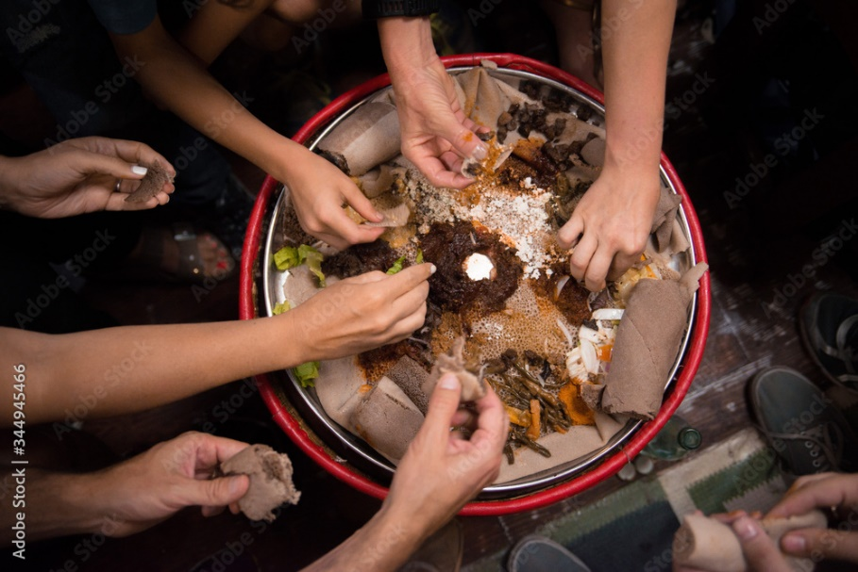
Background
VDH was notified on July 31, 2023, about a suspected foodborne illness related to Restaurant A located in northern Virginia.
Ill persons were reported to have Salmonella infection, including several with Shiga toxin-producing E. coli (STEC) co-infections, with illness onset in late July.
Initial interviews with ill persons indicated consumption of kurt and kitfo, traditional Ethiopian raw beef dishes, as a potential source of illness.
Cooked and raw foods may be served together on a shared platter
An investigation was initiated and included local health districts, state partners, and the VA Rapid Response Team (RRT).
Notes:
Background into outbreak investigation:
Virginia Department of Health was notified on July 31, 2023 of a suspected foodborne illness related to restaurant A in Northern VA. A local hospital IP reached out to the neighboring local health district to alert them of an increase in GI illness and positive Salmonella lab results, with patients reporting similar exposures of consuming food from restaurant A.
In addition to Salmonella infection, several ill persons reported co-infection with Shiga toxin-producing E.coli (or STEC), all with illness onset in late July.
Upon initial case interviews, ill persons indicated consumption of kurt and kitfo, which are traditional Ethiopian raw beef dishes, as their potential source of illness
Common for Ethiopian dishes to be served together on a shared platter and individuals will eat communally/family-style
Thus with a cluster of GI illness reporting similar restaurant exposures, a foodborne illness investigation began and involved several local health districts, state partners, and the Virginia Rapid Response Team.

Slide 3
Virginia Rapid Response Team (RRT)
Notes:
As I mentioned the VA rapid response team, I wanted to give some more detail on which groups are involved in that team. While Arlington County led the foodborne outbreak investigation, there was support from the Virginia Rapid Response Team in the food traceback and national laboratory surveillance.
VA is a Rapid Response Team state, comprised of these state and federal partners, and we collaborate regularly during outbreak investigations.
The Virginia RRT’s mission is to provide a rapid, unified, multi-agency all hazards response to food/feed emergencies

Slide 4
Investigation
The Arlington County Public Health Division (ACPHD) led the investigation
Communicable Disease Program
Designed case-control study to investigate outbreak
Collected data through interviews with ill and well persons
Cleaned and analyzed interview data using RStudio (2023) and SAS 9.4
Environmental Health Program
Conducted multiple environmental assessments at Restaurant A to ensure compliance with food safety regulations and mitigate risk
Solicited invoices for all meat products and supplier information
A REDCap survey was developed to obtain food history and signs/symptoms of illness from patrons.
The VA RRT performed traceback investigations of all available meat products.
Coordinated with the Virginia Department of Agriculture and Consumer Services (VDACS) Office of Meat and Poultry (OMPS) to collect raw beef samples for laboratory testing
Collaborated with the Maryland RRT
The VA Division of Consolidated Laboratory Services (DCLS) performed testing.
Cultured clinical specimens and performed WGS
Conducted food testing of leftover frozen kurt and kitfo, collected from an ill person's home, and samples from a single lot of frozen raw beef shanks collected directly from Restaurant A
Notes:
The foodborne investigation was led by the Arlington County Public Health Division’s two programs: communicable disease and environmental health.
A case-control study design was selected to investigate the outbreak as we worked retrospectively to identify exposures or risk factors that were associated to illness
The main form of study data collection was through interviews on both ill and well persons
We then cleaned raw interview data using Rstudio, and analyzed data using SAS (both programs using for statistical computing)
Arlington Environmental Health conducted multiple environmental assessments at Restaurant A to ensure compliance with food safety regulations and risk mitigation
Arlington EH also solicited invoices for all meat products and supplier information
VDH and Arlington County worked to develop a REDCap survey as our main interviewing tool to obtain food history and symptoms of illness from patrons
The Virginia Rapid Response Team performed traceback investigations for all available meat products and coordinated with the Virginia Department of Agriculture and Consumer Services, or VDACS, office of Meat and Poultry to collect raw beef samples for lab testing. We also collaborated with the Maryland Rapid Response Team during the traceback investigations
Our state public health lab, DCLS, performed testing on clinical specimens including cultures and whole genomic sequencing
DCLS also conducted food testing of leftover frozen kurt and kitfo, collected from an ill person’s home. Additional food testing included samples from a single lot of frozen raw beef shank collected directly from Restaurant A.

Slide 5
Epidemiological Results
The ACPHD led investigation involving Restaurant A:
91 ill persons met the outbreak case definition (43 lab confirmed; 17 were co-infected with STEC)
38 well persons (controls) were identified
96% of ill persons (cases) reported consuming raw beef dishes at Restaurant A, served from July 27 – July 31, 2023
OR = 9.82 (95% CI 2.69-45.36) for consumption of raw beef dishes
Multistate cluster of cases identified via PulseNet national laboratory network:
Included 98 isolates from ill persons in 14 states
All matched the Salmonella Typhimurium outbreak strain, within 0-1 alleles via whole genome sequencing (WGS)
39% (N=36) of cluster cases reported exposure to Restaurant A
Notes:
Our case definition for this outbreak was a person who ate food from Restaurant A between July 27 and July 31, 2023, with illness onset on/after July 27 and laboratory evidence of Salmonellosis or symptoms of vomiting and/or diarrhea.
A control was a person who ate food from Restaurant A between July 27 and July 31, 2023, with no illness.
91 ill persons (cases) met our outbreak case definition (which included 43 lab confirmed Salmonellosis, 17 of which were co-infected with STEC).
38 well persons (controls) were identified
96% of our cases reported consuming raw beef dishes from Restaurant A between July 27 and July 31, 2023.
Our analyses resulted in an odds ratio of 9.82 for consumption of raw beef dishes, indicating that: When eating any raw or undercooked beef from Restaurant A, individuals had about 9.82 times greater odds of salmonellosis infection compared to an individual who did not eat any raw or undercooked beef from Restaurant A.
Multistate/WGS investigation
Not all VA residents that matched into the cluster reported eating at restaurant A. Several reported eating raw beef but did not provide information on where it was consumed.
Further lab testing indicated this cluster of Salmonella Typhimurium was part of a multi-state cluster involving additional cases with no exposure to Restaurant A, including ill persons from 14 states
All 98 isolates matched the Salmonella Typhimurium outbreak strain and were genetically indistinguishable from one another
This multi-state investigation was led by VDH

Slide 6
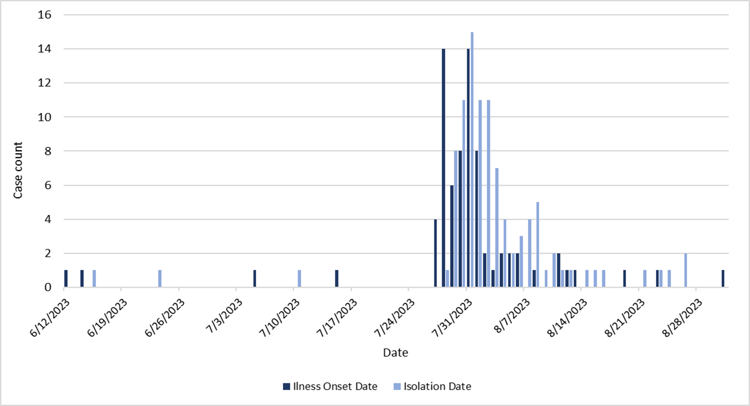
Epidemiological Results
Multistate S. Typhimurium Cluster Cases by Illness Onset and Isolation Dates (N=98)
Multistate S. Typhimurium Cluster Data (N=98)
Outcomes | N (%)
Total isolates | 107: 98 (clinical), 9 (food)
States involved | 14
Onset dates | 6/12/2023 - 8/31/2023
Isolation (specimen collection) dates | 6/15/2023 - 8/26/2023
Age (Years) | 0 - 78
Median | 35
Reported sex
Female | 45 (46%)
Male | 52 (53%)
Unknown | 1 (1%)
Hospitalized | 19 (19%)
Exposure period at Restaurant A: 7/27/23-7/31/23
Notes:
Graph on the left visualizes illness onset date (dark blue) and Salmonella isolation date (light blue)
Also highlighted the exposure period relative to the onset dates, we can see the exposure period at restaurant A correlating to the sharp increase in illness onset
Mention several denied eating at restaurant A
Table outlines demographic details of the 98 individuals counted toward the S. typhimurium cluster

Slide 7
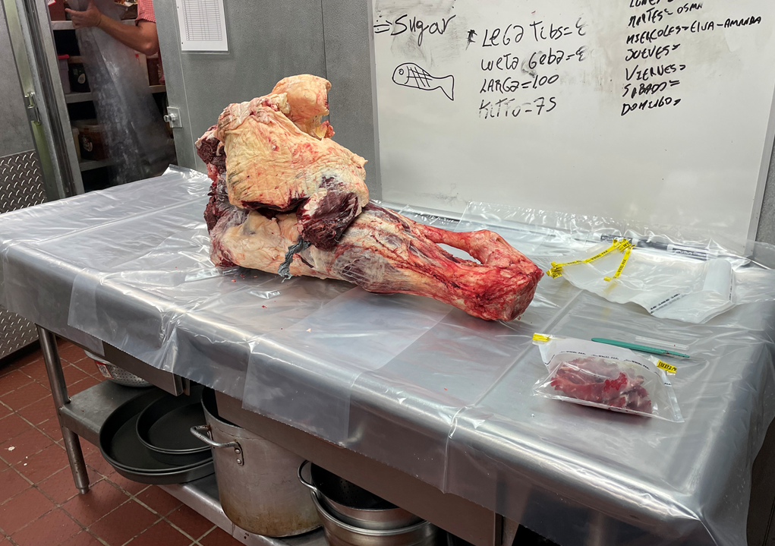
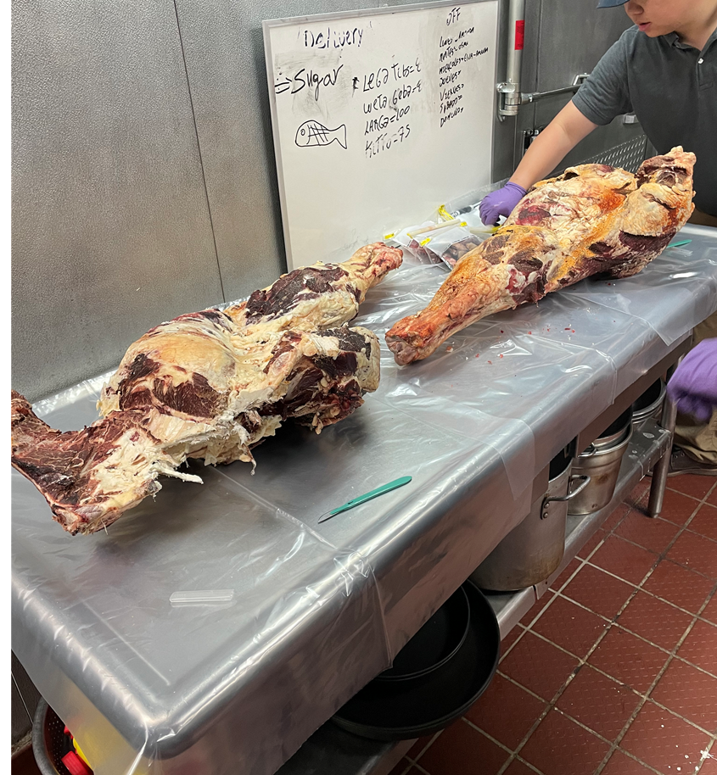
Environmental Assessment and Traceback
Restaurant A had sourced meat from an unapproved vendor which was used in the kurt dishes served during the time cases reported eating at Restaurant A.
Remediation activities were conducted at Restaurant A to help mitigate risk of further exposure to patrons:
Deep cleaning and temporary removal of raw meat dishes from the menu.
VDACS OMPS embargoed 375 lbs. of raw beef shanks from Restuarant A that did not have a USDA or VDACS stamp marking.
This unapproved vendor had also distributed raw beef to another Ethiopian market in the NCR.
USDA FSIS conducted an investigation into the unapproved vendor.
Notes:
Julia will provide more in-depth discussion on Arlington EH’s role in environmental assessment
Briefly; it was discovered Restaurant A sourced meat from an unapproved vendor which was used in the raw beef kurt dishes served during the exposure period
Remediation activities included deep cleaning of the restaurant and temporary removal of raw meat dishes from the menu to help mitigate risk of further exposure
VDACS office of meat & poultry embargoed 375lbs of raw beef that did not have the USDA/VDACS stamp marking
It was learned the unapproved vendor had distributed raw beef to another Ethiopian market in the NCR, and USDA food safety & inspection service conducted further investigation into the unapproved vendor

Slide 8
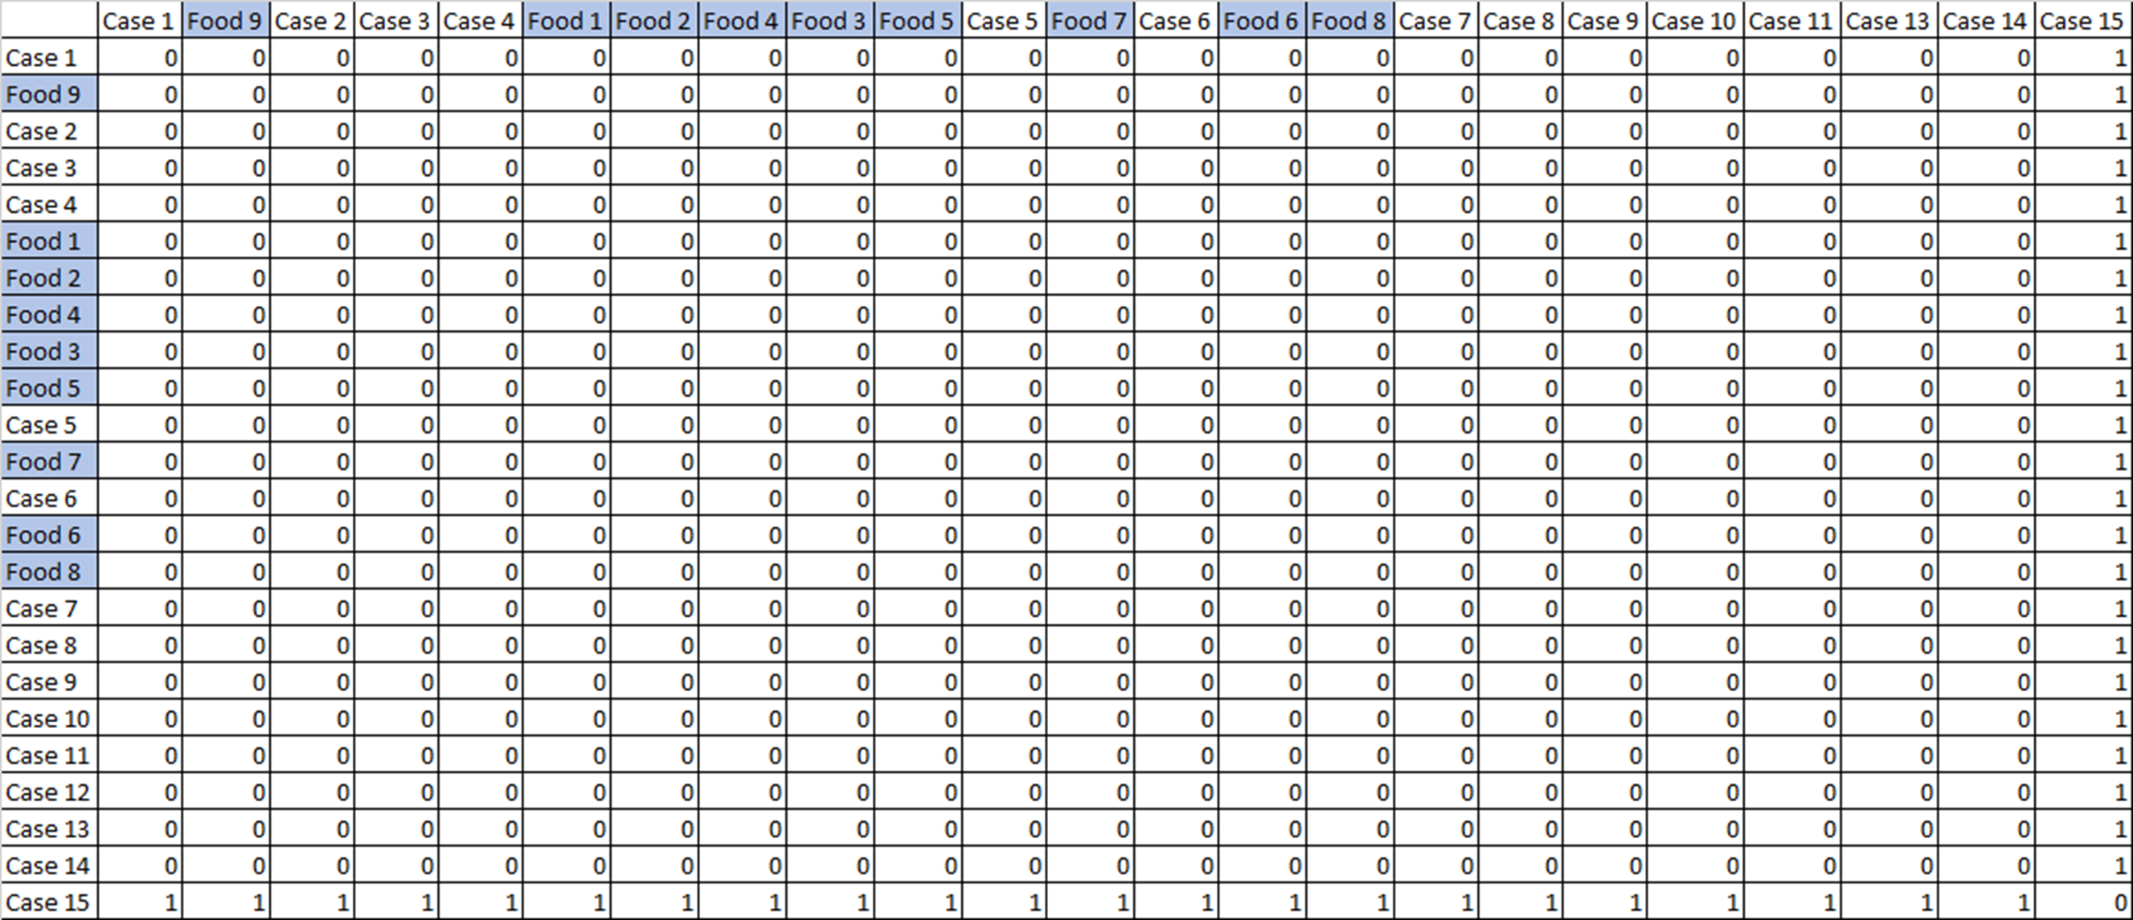
Laboratory Results
DCLS performed clinical specimen testing and food testing of leftover frozen kurt and kitfo collected from an ill person's home and raw beef shanks collected from Restaurant A.
Conducted WGS comparison for 45 clinical isolates and food isolates from 7 samples
The outbreak strain of S. Typhimurium was recovered from the leftover kurt and kitfo, and raw beef shanks.
All isolates were highly genetically related by WGS cgMLST analysis, within 0-1 differentiating alleles.
Multistate S. Typhimurium Cluster Allele Comparison of Human and Food Isolates
Notes:
As aforementioned, DCLS performed clinical specimen and food testing of leftover frozen kurt and kitfo from an ill restaurant patron’s home, and raw beef shanks collected from Restaurant A
The outbreak strain of S. typhimurium was isolated from all food isolates
The Whole Genomic Sequencing comparison for clinical isolates and food isolates is displayed on the right, showing 0-1 allelic differences between food/clinical isolates, indicating high levels of genetic similarity

Slide 9
Limitations
Epidemiologic analyses (odds ratios) are based on self-reported data – potential recall & interview bias
Minimized by timely administration of case interviews, and by providing REDCap survey to all involved health departments to allow for standardized measures of exposure
Study design limited by outbreak setting; unable to conduct cohort study to calculate relative risk
Difficult to identify every individual who consumed food from Restaurant A over the exposure period
Case-control study allows us to calculate odds ratio, an estimate of relative risk
Small sample size and selection bias among controls; decreased power in effect measure estimates
Despite small number of controls, study yielded significant odds ratios
Language and/or cultural differences influencing exposure data collection
Minimized by inclusion of menu item descriptions in REDCap survey
Language interpretation offered as needed
Notes:
Our study had several limitations:
First, the epi analyses are based in self-reported data, which are subject to potential recall and interview bias. However, these biases were minimized by the timely administration of case interviews, and by providing the REDCap survey to all involved health departments to allow for a standardized measure of exposure
Second, the study design was limited by the outbreak setting: we were unable to conduct a cohort study to calculate relative risk as it was difficult to identify all perons who consumed food from restaurant A in our exposure period. However, the odds ratios calculated are an estimate of relative risk and still allow us to identify likely sources of illness
Third, small sample size and selection bias among controls may have led to decreased power in the effect measure estimates. However despite the small number of controls, we produced a significant odds ratio
Lastly, language and/or cultural differences may have influenced exposure data collection. This was minimized by including menu item descriptions in the REDCap survey for our interviewers to reference, and language interpretation was offered as needed

Slide 10
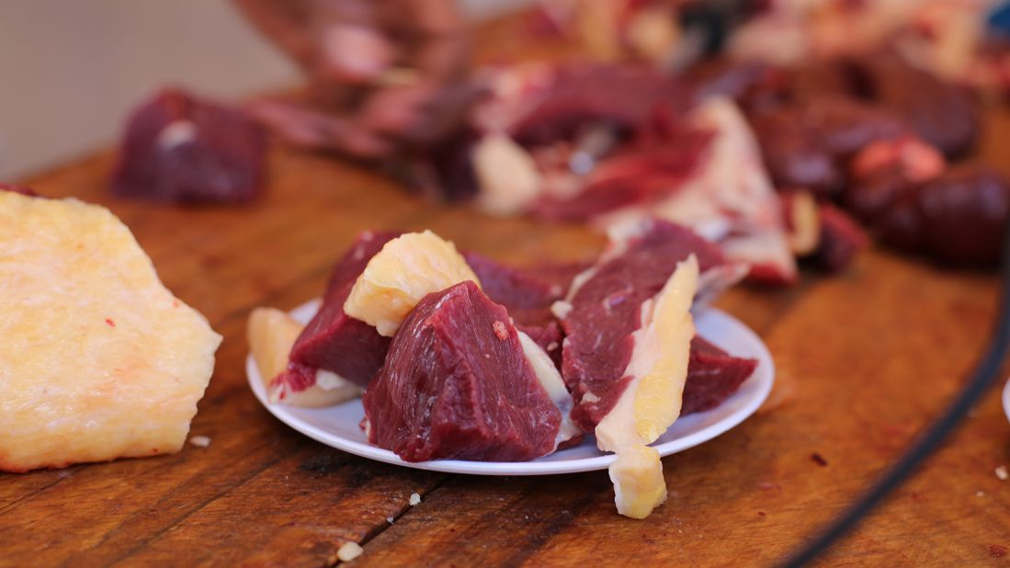
Conclusions/Recommendations
Based on laboratory and epidemiologic findings, the contaminated raw beef products were determined to be the cause of this outbreak.
Kurt and kitfo are traditional beef dishes, served raw, that will continue to be consumed within Ethiopian communities.
This investigation demonstrated the importance of providing education to restaurant owners about purchasing foods, especially meats that will be consumed raw, from approved sources or vendors.
Notes:
Conclusions and recommendations moving forward based on the findings of this outbreak investigation:
Ultimately, based on lab and epidemiologic findings, the contaminated raw beef products were determined to be the cause of this outbreak.
Kurt and kitfo are traditional raw beef dishes that will continue to be consumed within Ethiopian communities
And the investigation demonstrated the importance of providing education to restaurant owners about purchasing foods, especially meats for raw consumption, from approved sources and/or vendors.

Slide 11
Questions?
Acknowledgements:
The Arlington County Public Health Division (ACPHD)
Sahill Patel
Lisa Guli
Candice Wooden
Julia Balsley
Bethelhem Kebede
Virginia Department of Agriculture and Consumer Services (VDACS)
Christy Brennan
Caroline Wilkinson
Office of Meat and Poultry (OMPS)
Virginia Department of Health (VDH)
Denise Sockwell
MaryBeth DeMarco
Olivia McCormick
Local Virginia Health Districts
Alexandria
Fairfax
Loudoun
Prince William
Chesterfield
Acknowledgements:
Division of Consolidated Laboratory Services (DCLS)
Jessica Maitland
Lauren Turner
Maryland Department of Health
SMarRT
FoodNet and Emerging Infections Program
DC Health
The Centers for Disease Control and Prevention (CDC)
Outbreak Response and Prevention Branch
United States Department of Agriculture (USDA)
Food Safety and Inspection Service (FSIS)
spatel@arlingtonva.us

