Slide 1
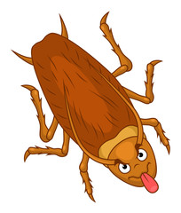
FUN THINGS ABOUT PESTS
(and Fun times)
Vicki Decker
Vice President of
Operations
and Strategic Growth

Slide 2
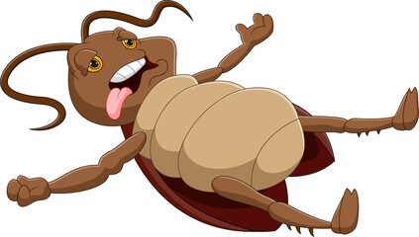
IS IT FRIDAY YET?????
Are we having fun yet?

Slide 3
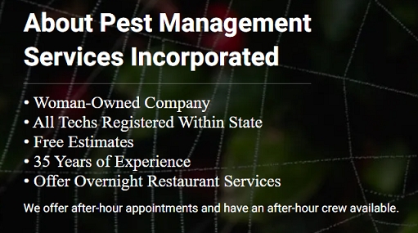
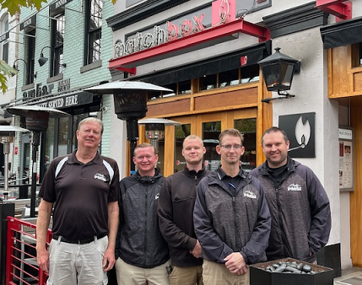
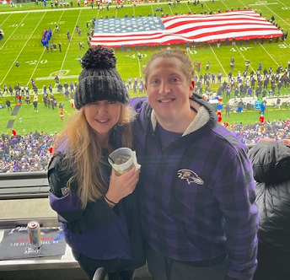
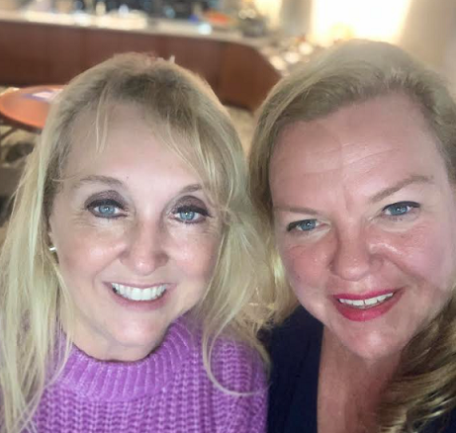
Notes:
Like most successful companies –comes from Great Owners and leadership

Slide 4
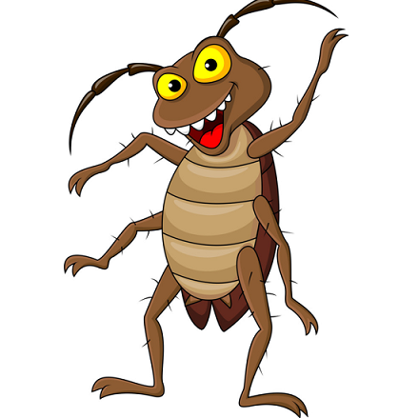
PEST ELIMINATION –
THE ULITMATE LOVE HATE
RELATIONSHIP

Slide 5
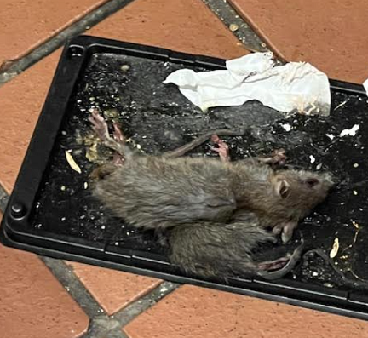
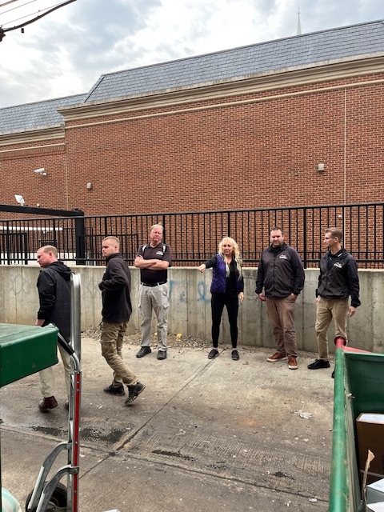
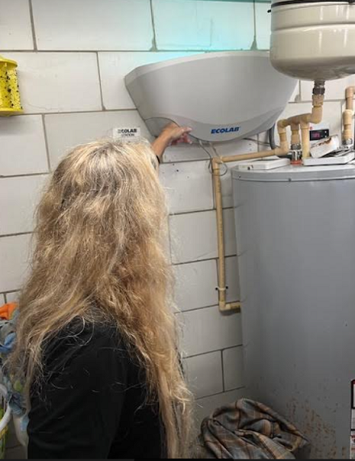
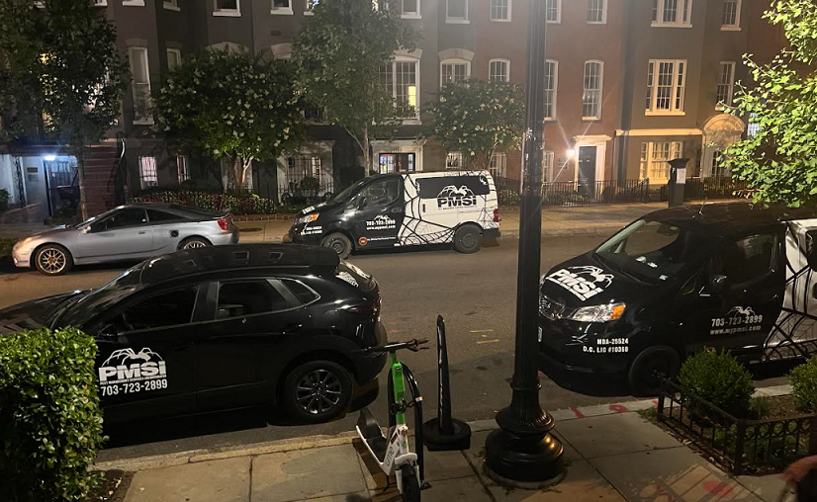

Slide 6
EVERYONE WANTS THE SAME THING

Slide 7
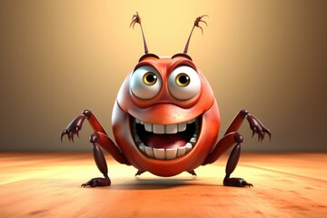
PROBLEM SOLVING FOR RESTAURANTS and COMMERCIAL ENTITIES

Slide 8
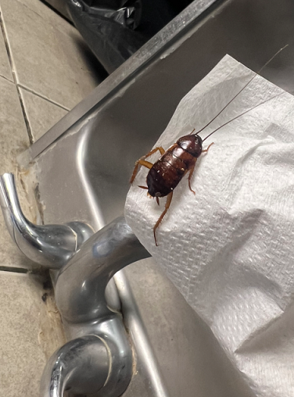
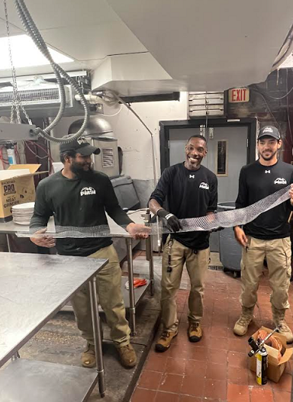

Slide 9
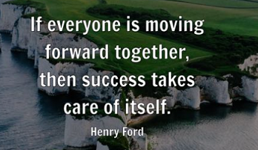
THE MOST SUCCESS COMES FROM…
TEAMWORK
COMMUNICATION
PARNTERSHIPS
Notes:
Have to take the good with the bad

Slide 10
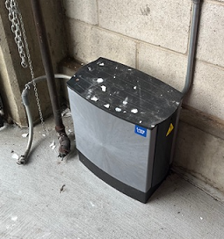
NEW TECHNOLOGY AND IDEAS
https://www.modernpest.com/uploads/Anticimex-SMART-Box-1.pdf

Slide 11
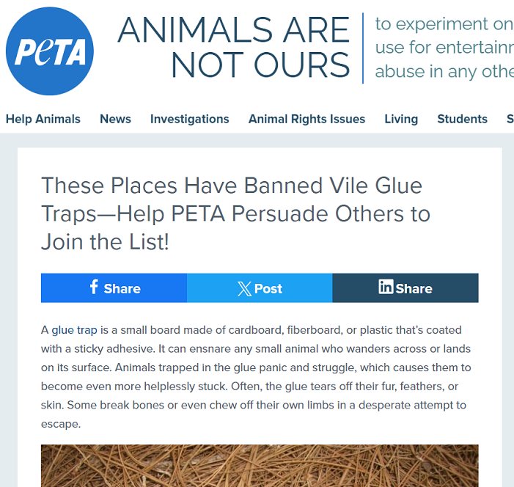
CHALLENGES

Slide 12
SOME OF THE FUN!!!!

Slide 13
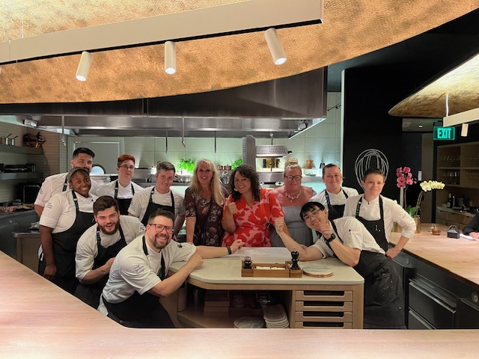
Pest Elimination to the stars!
Culinary Stars & Sports Icons
Even WE care of Michelin Stars!

Slide 14
