Slide 1
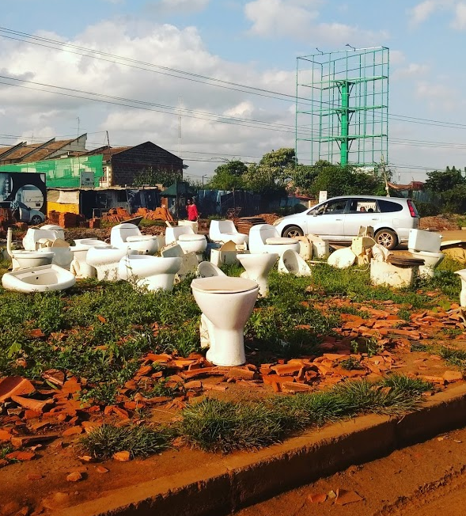
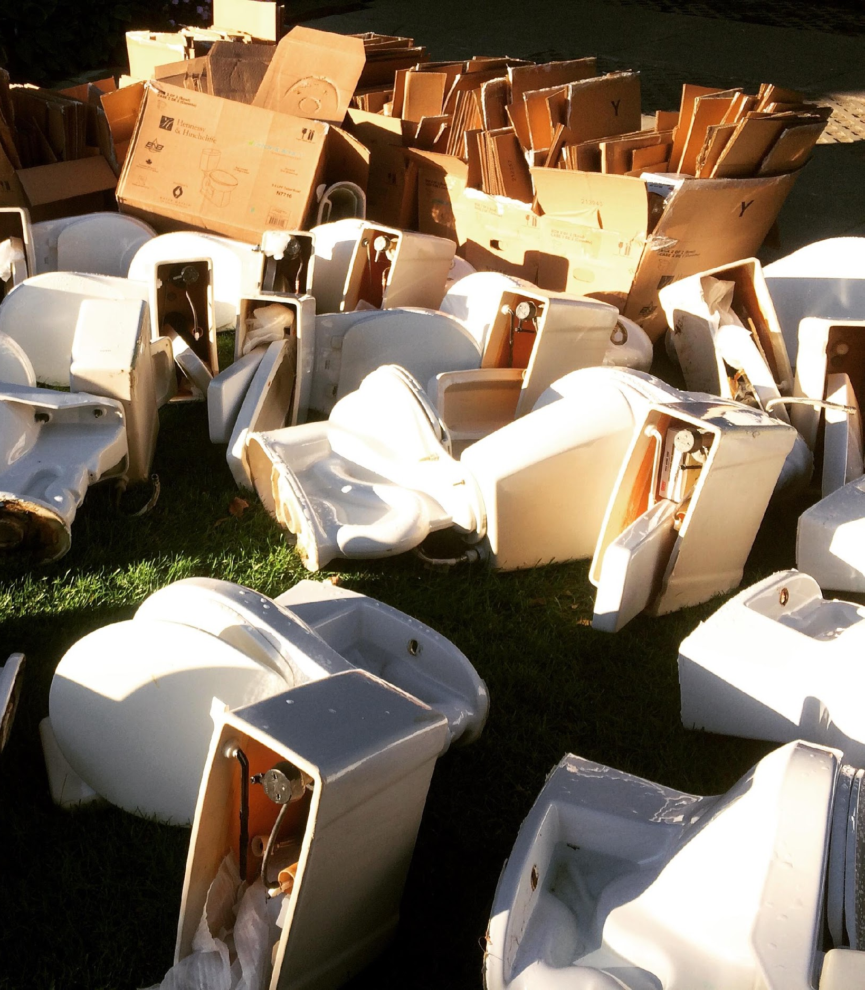
Discussing Sanitation Similarities between the US and Developing World
Roberta Hammond, PhD, RS
Kimberly Worsham, MPA, MIWM
Notes:
This could be the cover page to our presentation

Slide 2
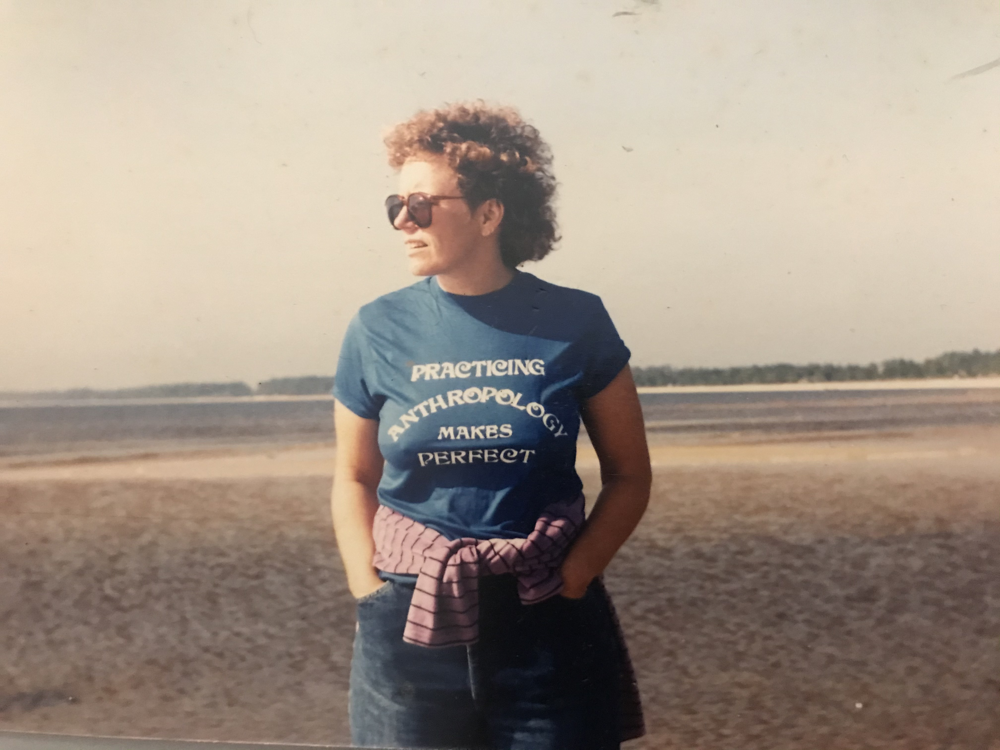
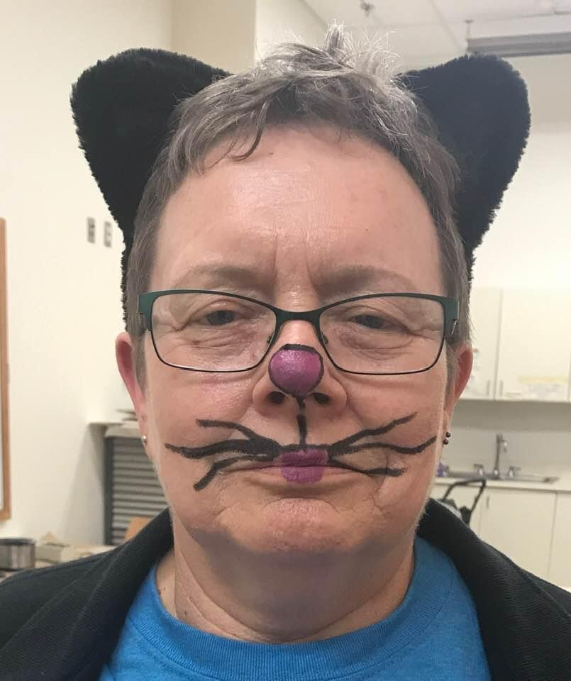
Meet Roberta

Slide 3
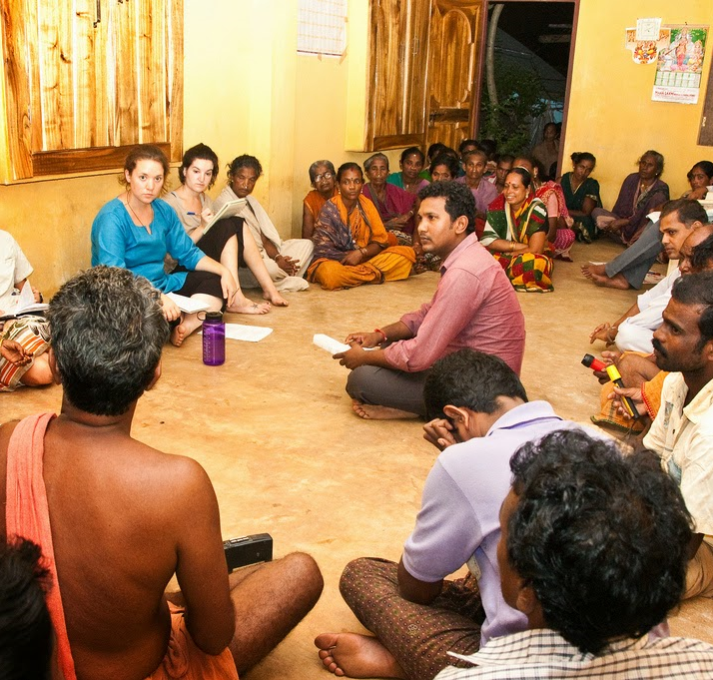
Meet Kim
Pic Cred: Maulin Mehta
Notes:
This is where I could talk about my personal sanitation stories

Slide 4
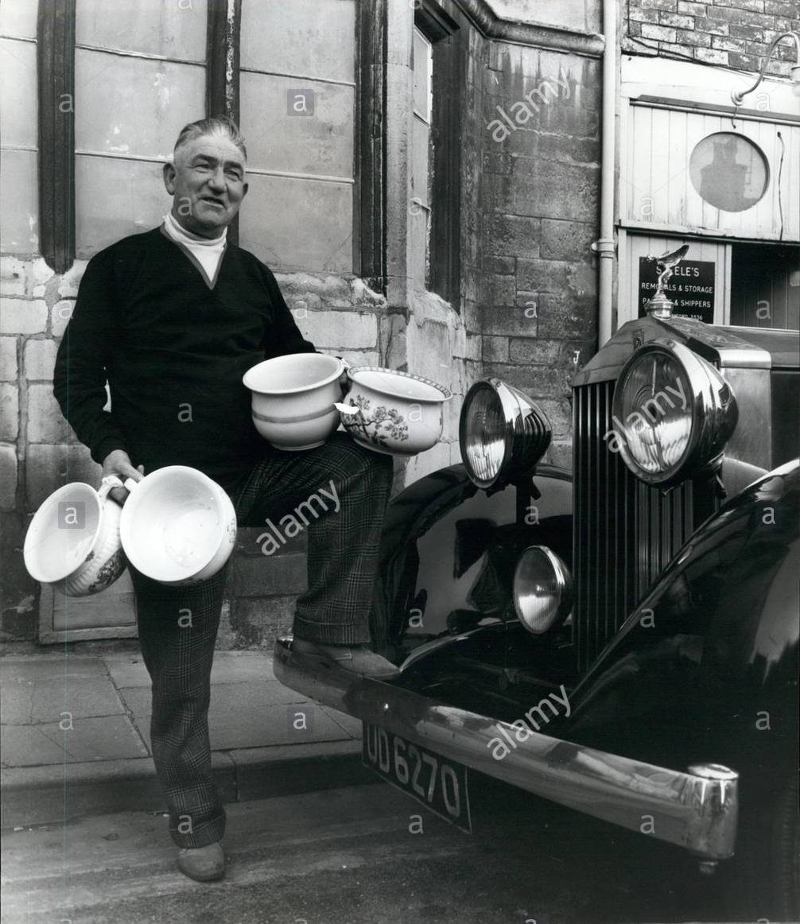
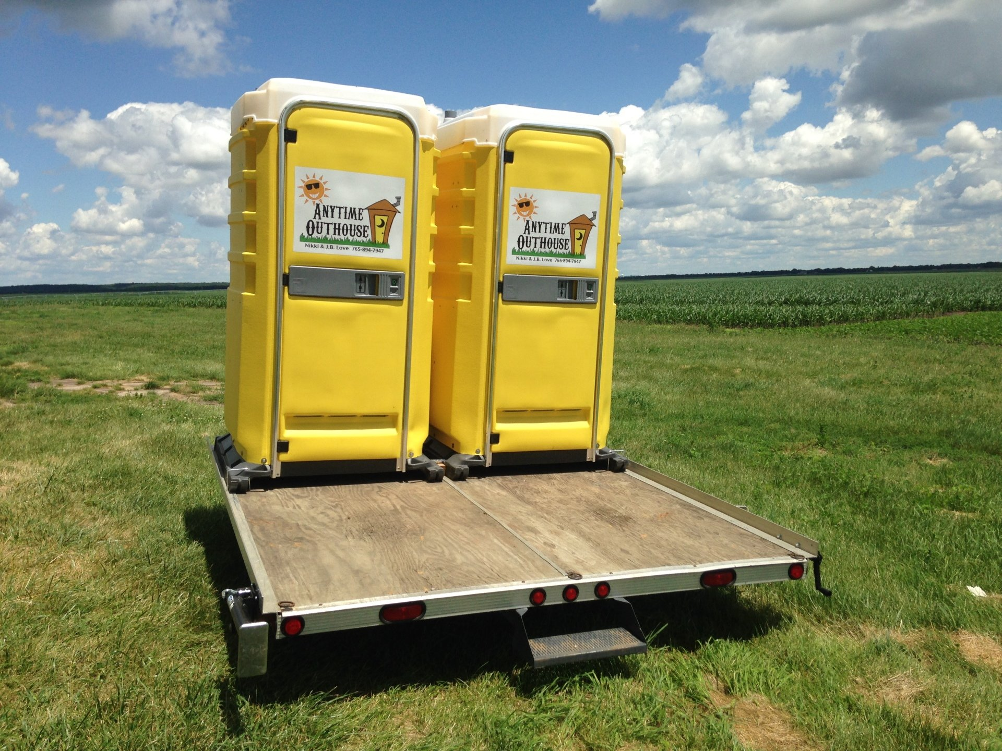
The US
Pic Cred: Anytime Outhouse
Notes:
Getting into WASH can be hard, especially if it's a career change and you're not an engineer

Slide 5
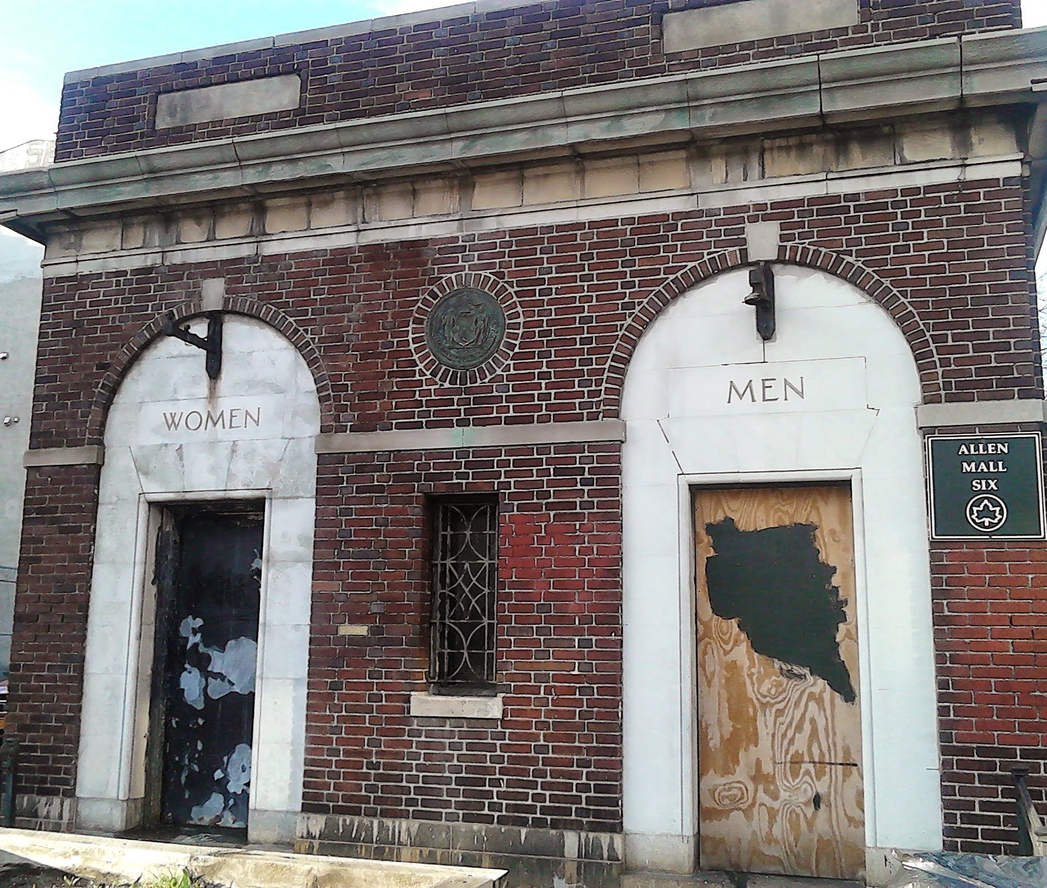
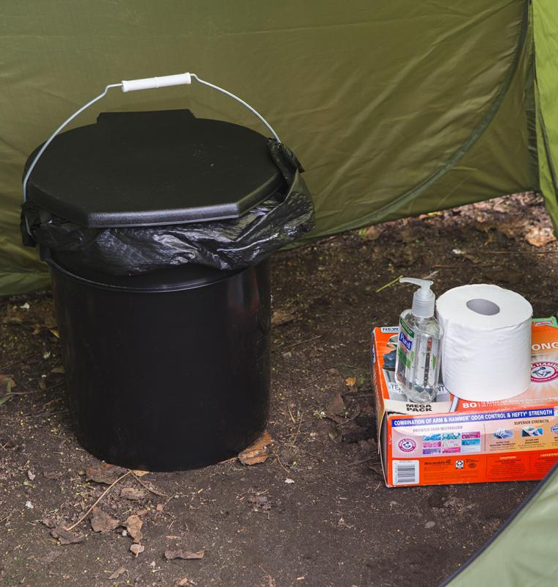
The US
Pic Cred: BigStock
Pic Cred: Matthew S Browning

Slide 6
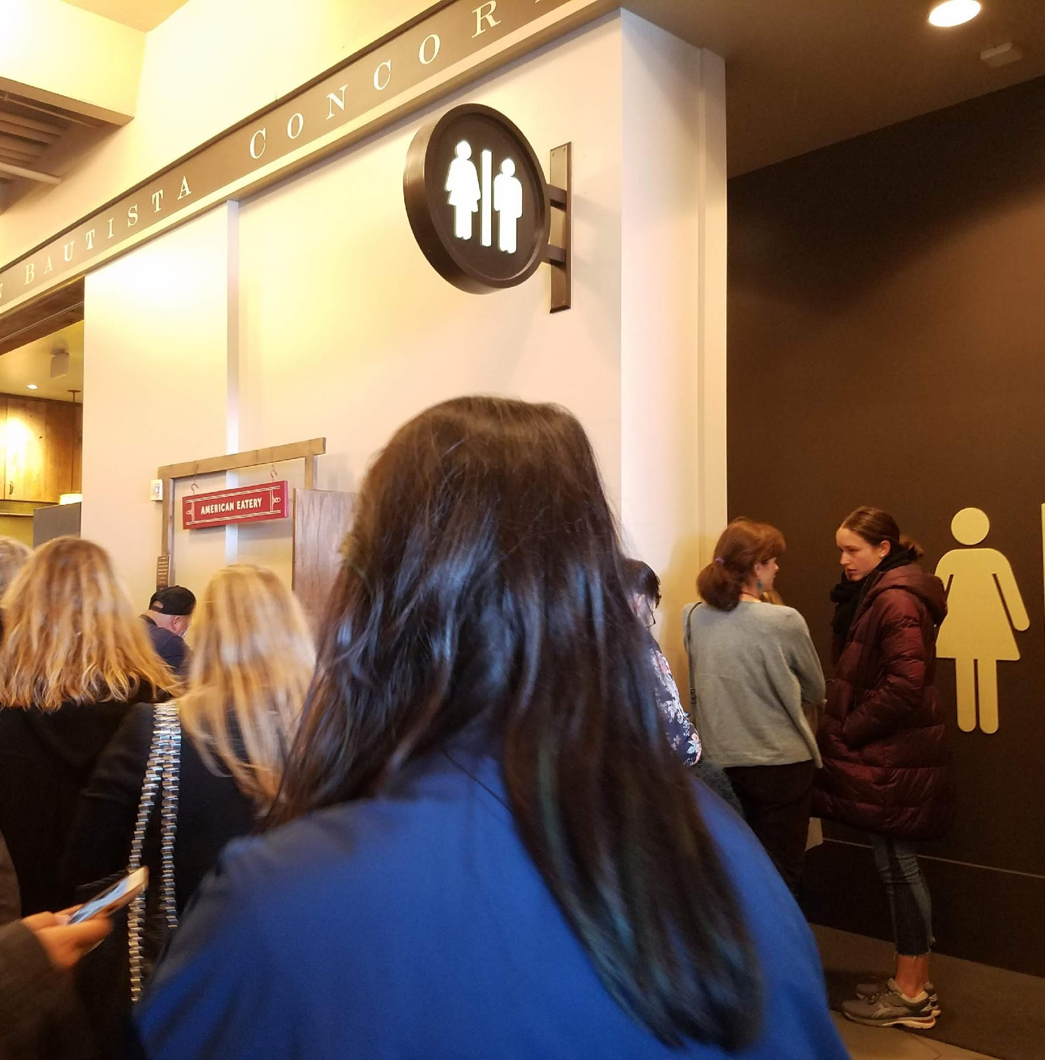
The US

Slide 7
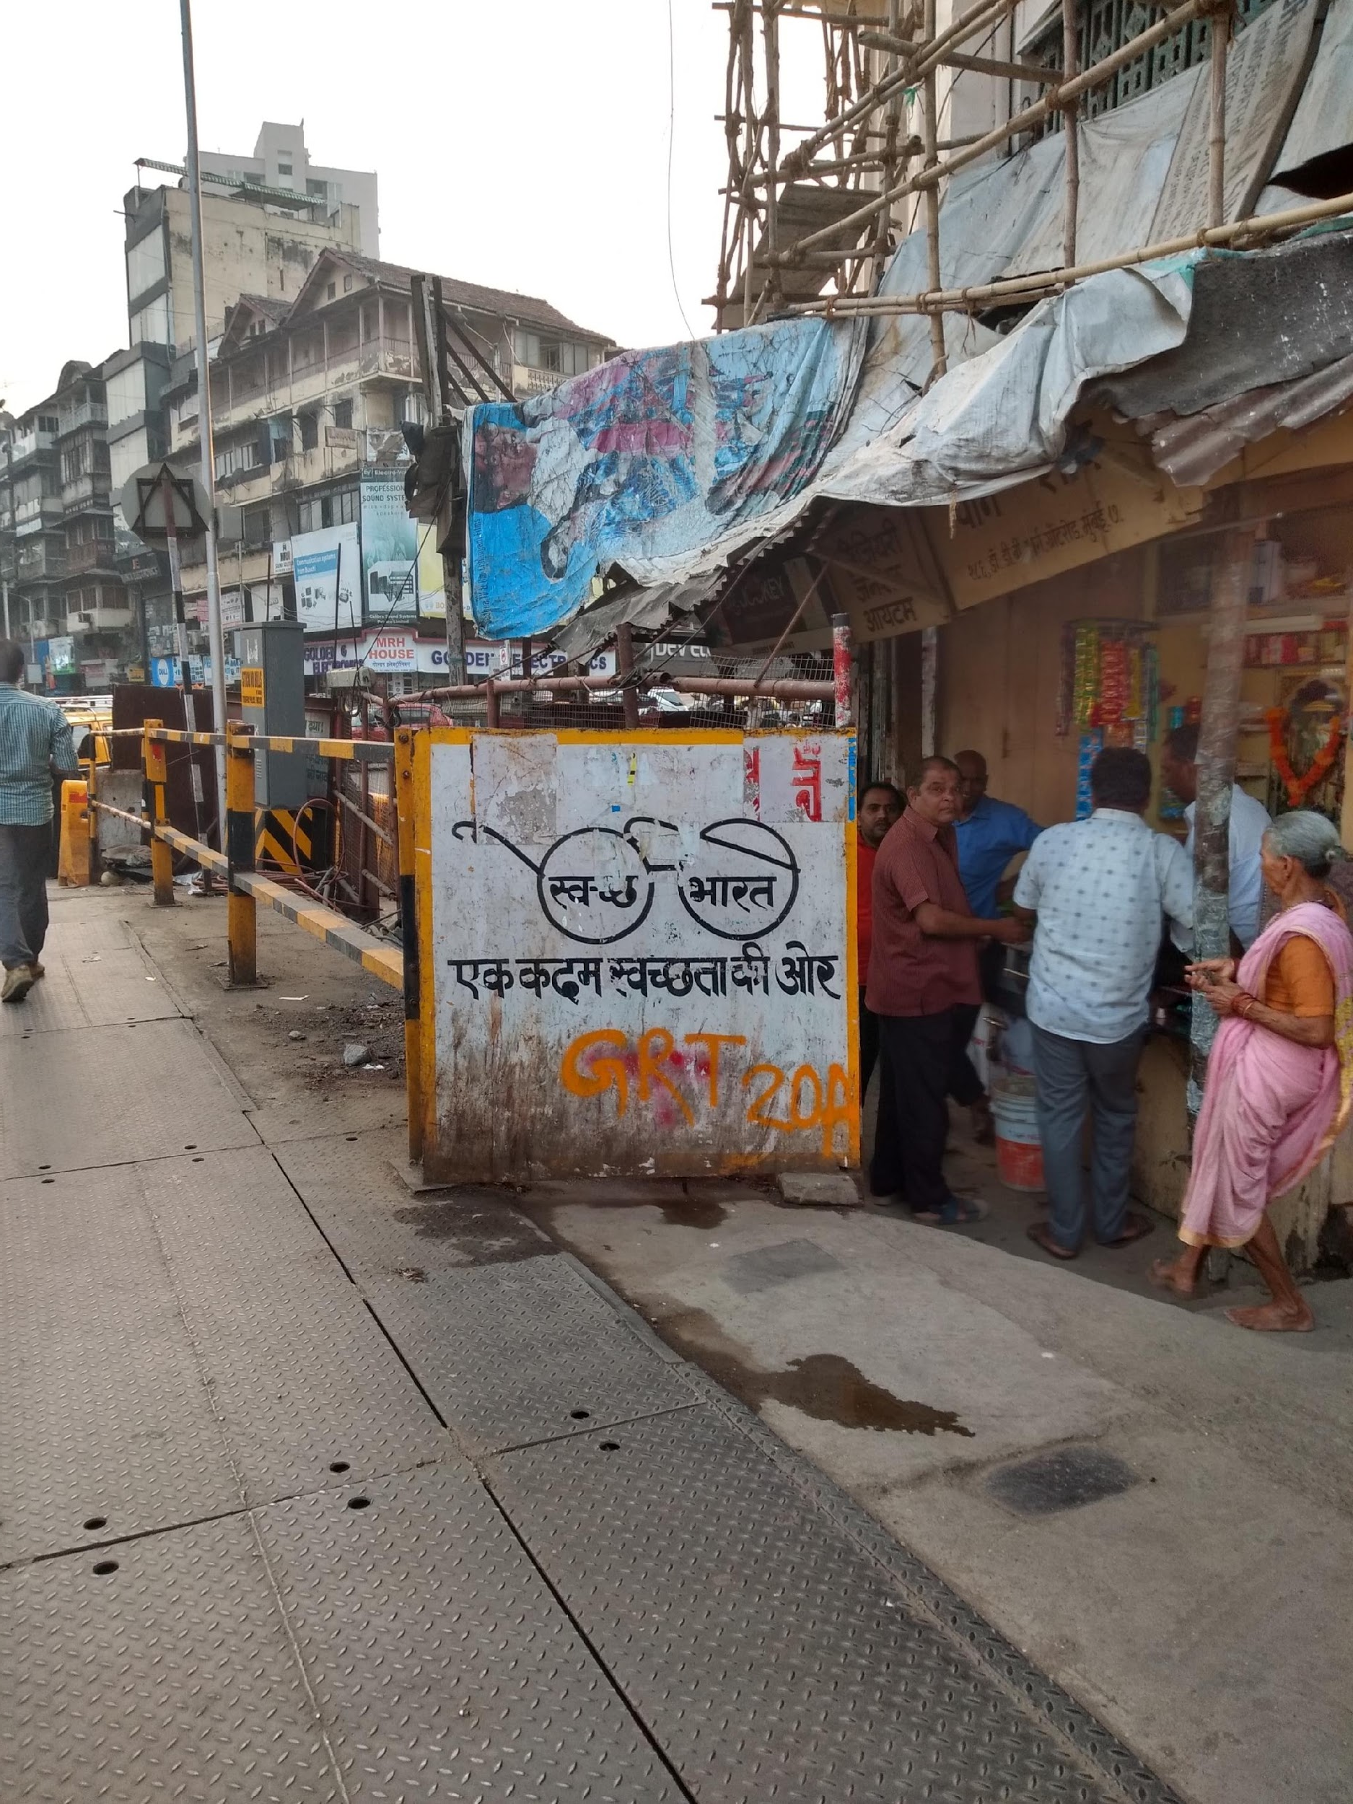
The Developing World:
India
Notes:
Mention India/Nepal/govt/media

Slide 8
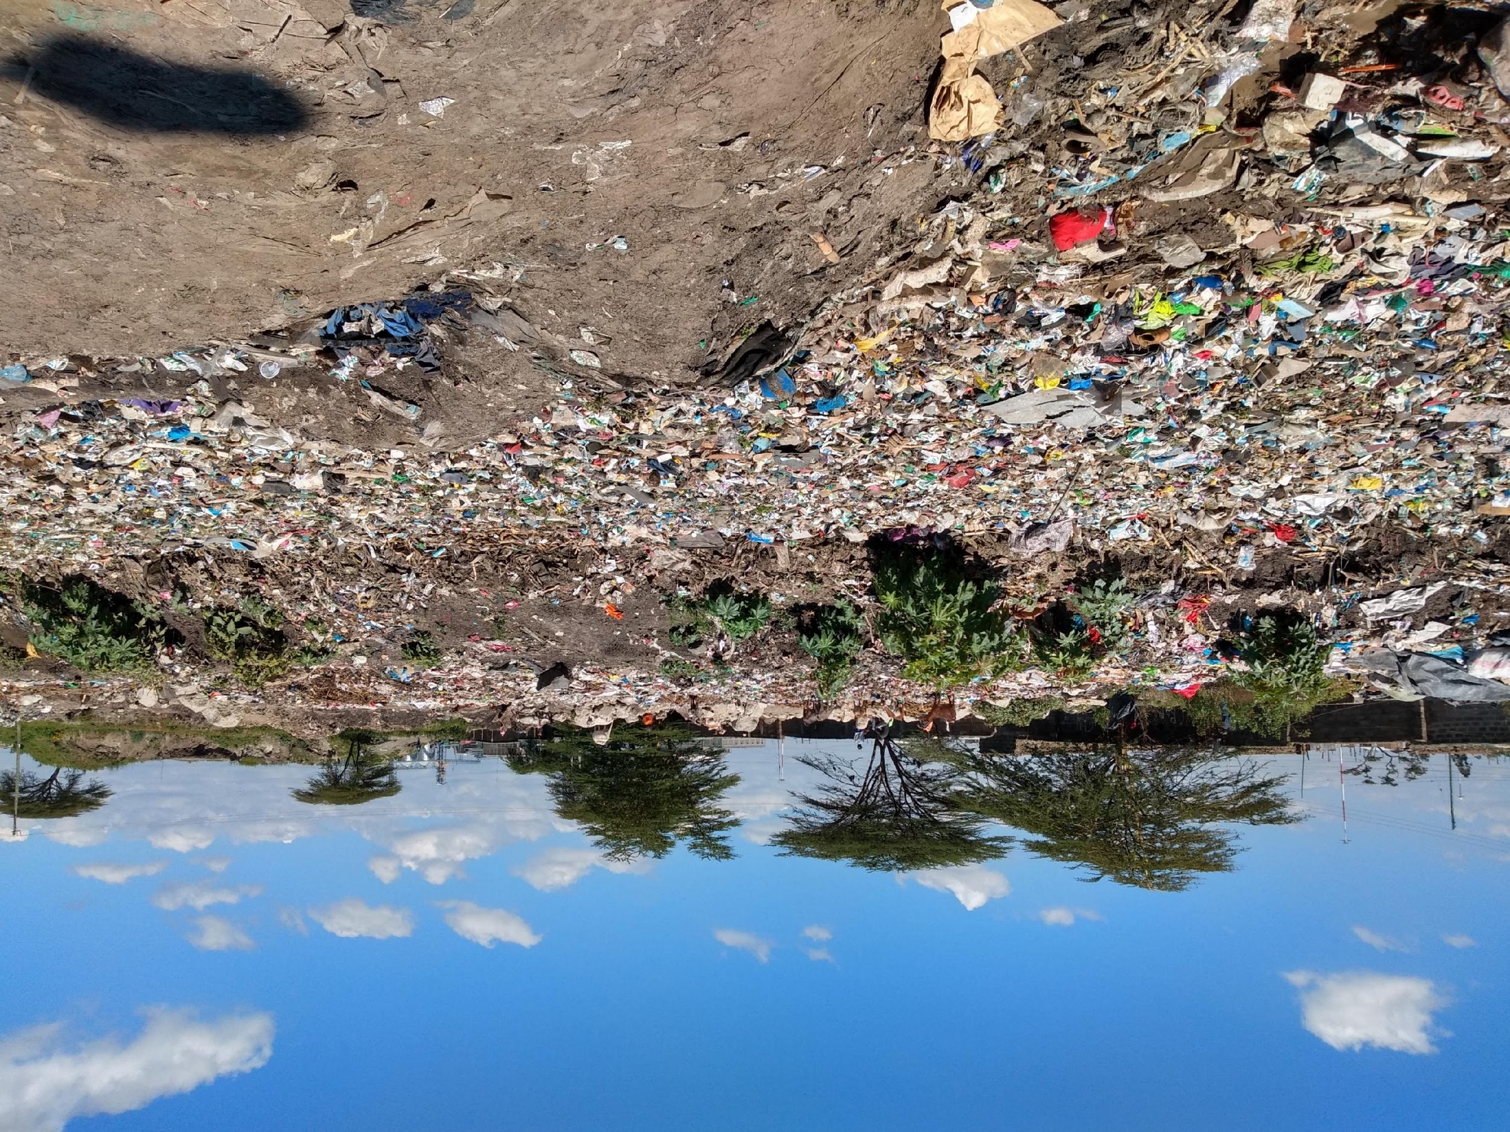
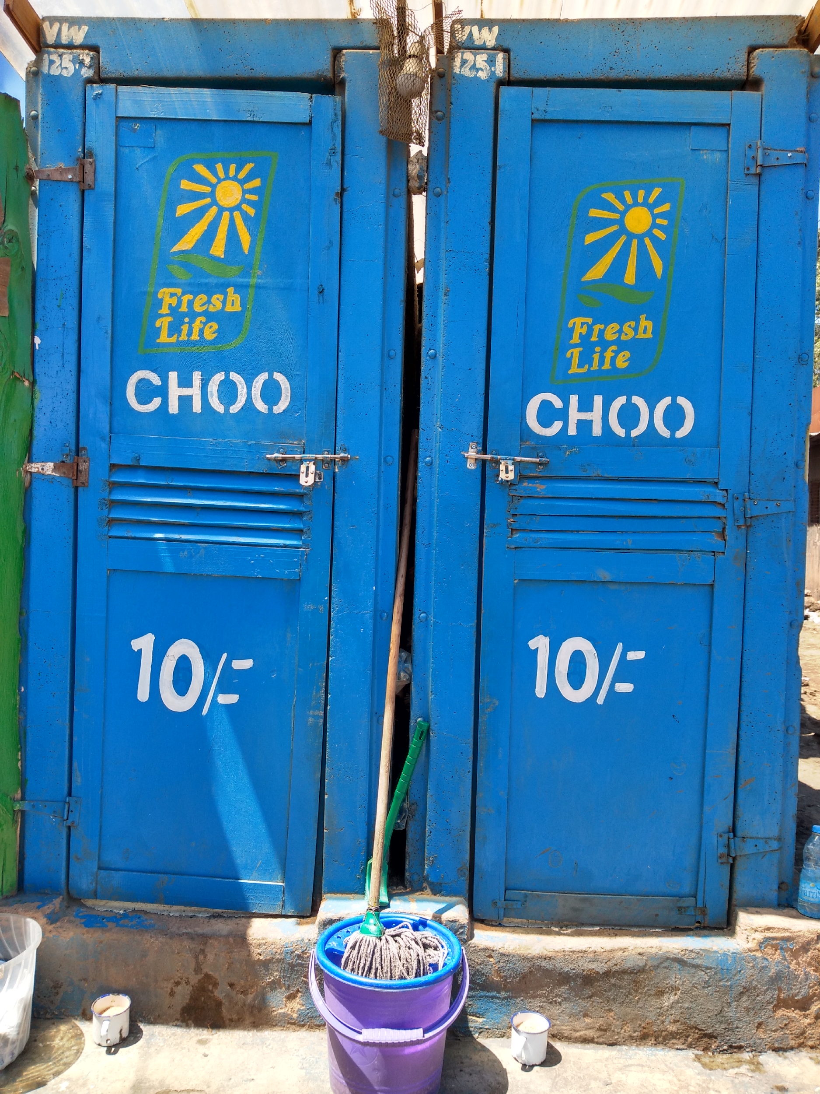
The Developing World:
Kenya
Notes:
Mention Kenya

Slide 9
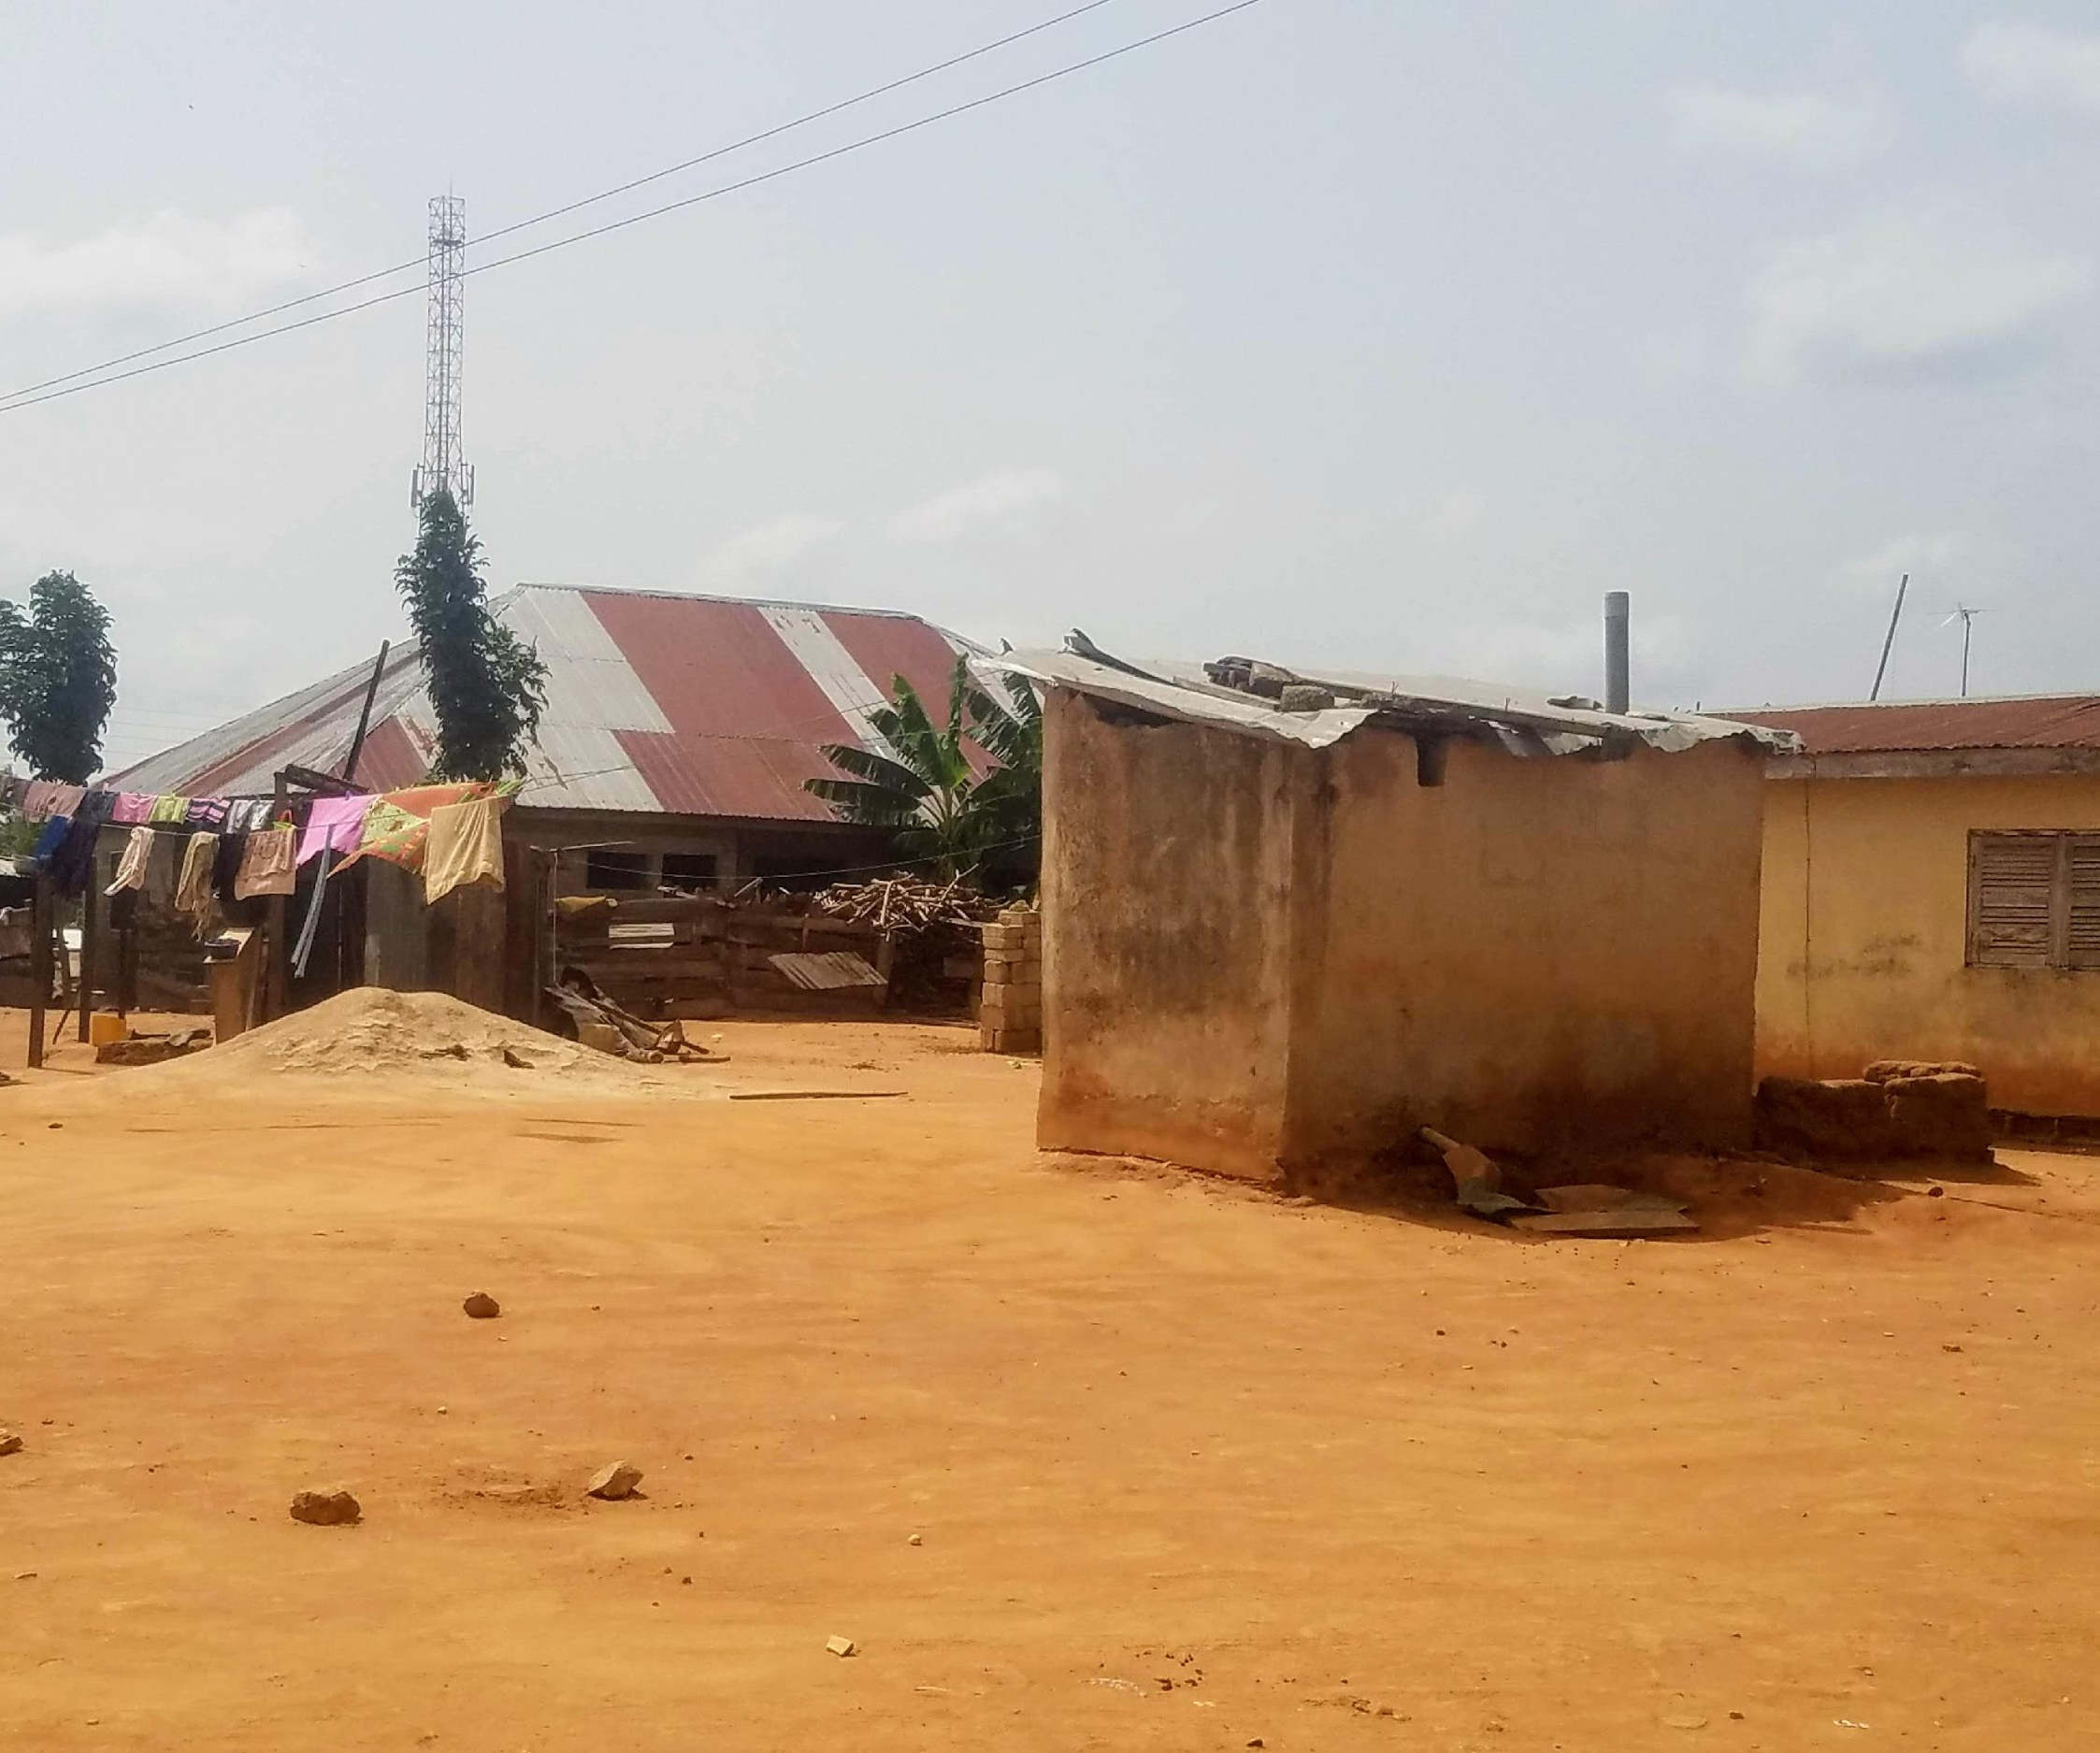
The Developing World:
Ghana
Notes:
Mention Ghana

Slide 10
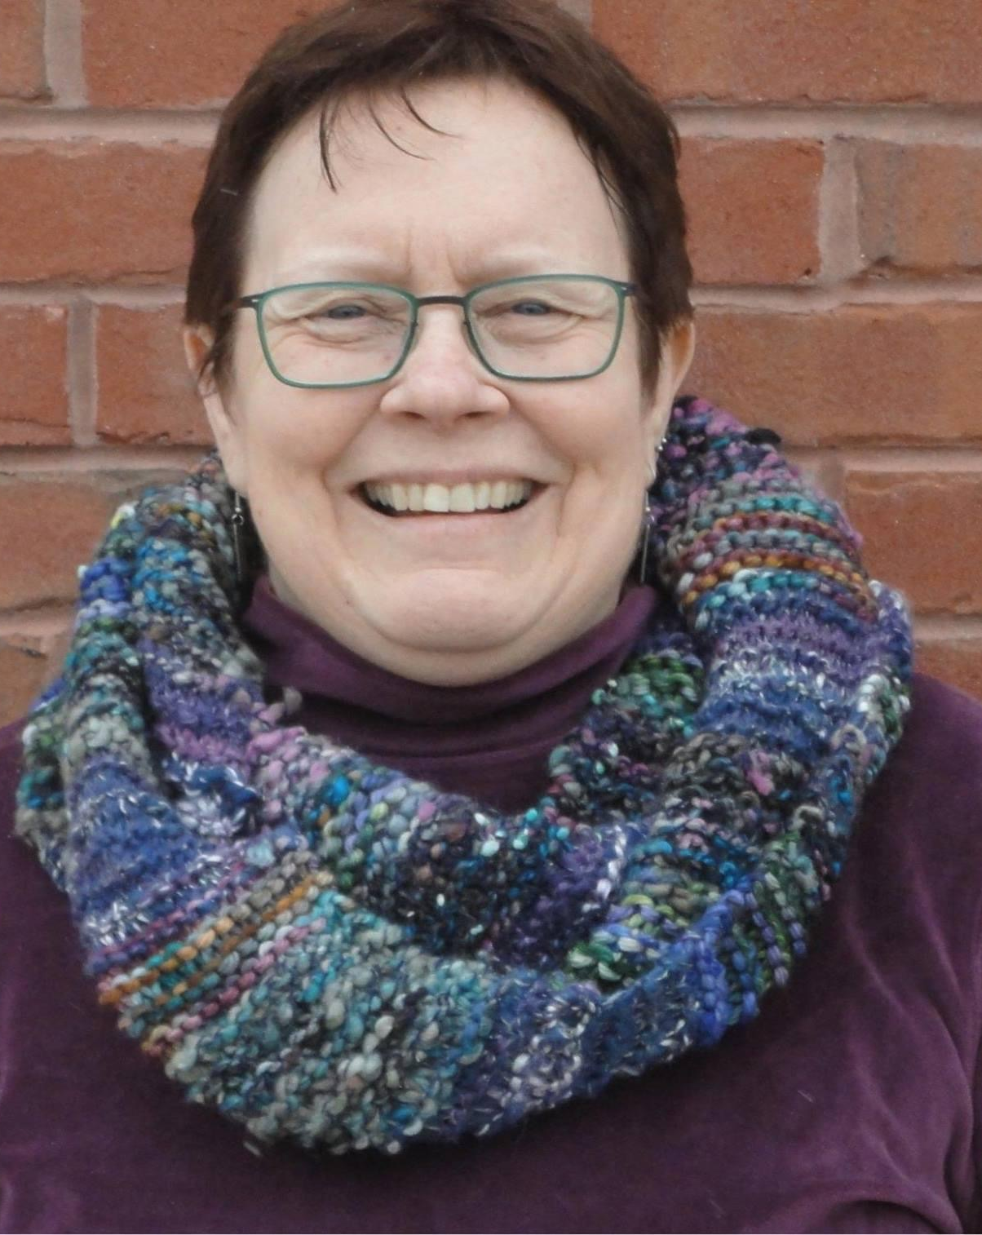
Thank you for listening!
bertah456@gmail.com
kim@flushwash.org www.flushwash.org
Notes:
I thought I’d add a pic of you here, too, as our final pic

