Slide 1
“WHAT THE FOMITE?”
By DEBORA Brown
Senior Environmental Health specialist, ms
Fairfax county health department
Consumer protection program

Slide 2
ICEBREAKER: Test Your Knowledge?
The word “fomite” is derived from:
A- a word for “ foaming or frothing”
B- a word for “microscopic bugs or mites”
C- a word for “kindling wood or tinder¹”
D- the name of an unfortunate celebrity child

Slide 3
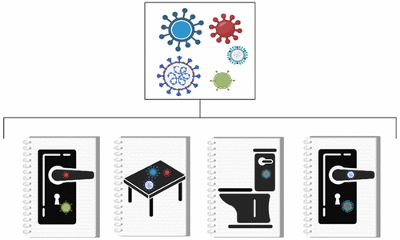
DEFINITION: WHAT IS A FOMITE?
According to the Merriam-Webster dictionary, it is defined as an object (inanimate) that may be contaminated with infectious agents (such as bacteria or viruses) and serve in their transmission².
According to the Cambridge English dictionary, it is defined as a physical object that is NOT a plant or animal that can spread a disease to a living creature³.

Slide 4
WHAT ARE SOME EXAMPLES OF FOMITES?
CROWD PARTICIPATION

Slide 5
BACKGROUND: WHAT IS A FOMITE?
Shift in 1987, CDC and American Hospital Association began to include fomites as additional factors for disease spread
In 2019, it was reported about 1.5 million deaths, worldwide, from diarrheal illnesses⁴
In 2019, it was reported about 4 million deaths, worldwide, from respiratory illnesses⁵
Most common infections are caused by respiratory and enteric viruses⁶

Slide 6
WHY ARE FOMITES IMPORTANT?
Fomites aid in disease transmission
Important to understand how the environment plays a role in the spread of diseases
As Environmental Health Specialists, it is important to understand how regulation compliance with specific practices such as washing, rinsing and sanitizing, disinfection and hand washing can reduce risk factors

Slide 7
TRANSFER EFFICIENCY OF FOMITES: Porous vs. Non-Porous
HIGH HUMIDITY- (40% TO 65% relative humidity)⁷
Greater transfer efficiencies for porous surfaces (13.4%)
Great transfer efficiencies for non-porous surfaces (79.5%)
LOW HUMIDITY- (15% TO 32% relative humidity)⁷
Lower transfer efficiencies for porous surfaces (6.8%)
Lower transfer efficiencies for non-porous surfaces (57%)

Slide 8
HOW DO FOMITES RELATE TO EH INSPECTIONS?
FDA 2017 Food Code
Water Recreational Facilities Ordinance
Sanitary Regulations for Hotels
EHP- 2-201.11
Exclusion vs Restriction- 2-201-12
Personal Cleanliness- 2-303.11 (Jewelry)
Eating, Drinking- 2-401.11 A, B
Cleaning- 4-601, 4-602, 4-603
Sanitization- 4-701, 4-702, 4-703
Laundering- 4-801, 4-802, 4-803
Communicable Diseases- Section 69.1-3-5
Placards- Section 69.1-3-4
EHP- 12VAC5-431-460
General Sanitation- 431-290
Housekeeping Carts- 431-430 C
Laundry- 431-340 F, G, H
Furnishings Clean/Good Repair- 431-320
Mattress Pads, Bedding, Linen- 431-340 B,C,D,E,I

Slide 9
HOW TO REDUCE DISEASE TRANSMISSION?: CLEANING VS SANITIZING VS DISINFECTING
Proper cleaning methods
Removal of dirt, debris, solids and organic matter
Preparing the proper sanitizing/ disinfection solutions
Proper concentrations
Proper contact times/ per chemical
www.epa.gov

Slide 10
NOROVIRUS OUTBREAK SICKENS MOREN THAN 300 PEOPLE- ABCNews
CDC reported Norovirus outbreak in Tazwell County, Illinois
317 people reported sick
Dined in restaurant during Thanksgiving week, Nov 19th to Nov 26th, 2022
Symptoms= vomiting, nausea and diarrhea
Culprit= ungloved food handler who prepared RTE food items (salad, toppings and dressings)

Slide 11
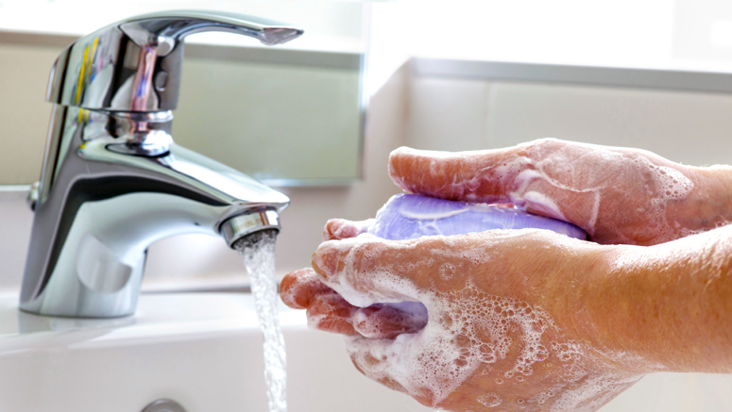
TAKE HOME MESSAGE: #1 Way to Prevent or Reduce the spread of infections??
HANDWASHING
-WET HANDS
-APPLY SOAP
-RUB/SCRUB HANDS TOGETHER FOR 20 SECS
-RINSE YOUR HANDS WITH WATER
-DRY YOUR HANDS WITH A PAPER TOWEL
-TURN OFF TAP WITH A PAPER TOWEL

Slide 12
Test Your Knowledge? FIND THE FOMITES…

Slide 13
QUESTIONS???

Slide 14
REFERENCES
1. Hale, LAUREN. What the heck is a fomite. Those nerdy girls. 26 mar 2021. https://thosenerdygirls.org/what-is-a-fomite/
2. FOMITE. MERRIAM-WEBSTER. HTTPS://WWW.MERRIAM-WEBSTER.COM/DICTIONARY/FOMITE
3. Fomite. Cambridge dictionary. https://dictionary.Cambridge.org/us/dictionary/English/fomite
4. Saloni Dattani, Fiona Spooner, Hannah Ritchie and Max Roser (2023) - "Diarrheal Diseases". Published online at OurWorldInData.org. Retrieved from: 'https://ourworldindata.org/diarrheal-diseases' [Online Resource]
5. GBD 2019 Chronic Respiratory Diseases Collaborators. Global burden of chronic respiratory diseases and risk factors, 1990–2019: an update from the Global Burden of Disease Study 2019. eClinicalMedicine. 25 April 2023. doi: 10.1016/j.eclinm.2023.101936.
6. Boone SA, Gerba CP. Significance of fomites in the spread of respiratory and enteric viral disease. Appl Environ Microbiol. 2007 Mar;73(6):1687-96. doi: 10.1128/AEM.02051-06. Epub 2007 Jan 12. PMID: 17220247; PMCID: PMC1828811.
7. Lopez GU, Gerba CP, Tamimi AH, Kitajima M, Maxwell SL, Rose JB. Transfer efficiency of bacteria and viruses from porous and nonporous fomites to fingers under different relative humidity conditions. Appl Environ Microbiol. 2013 Sep;79(18):5728-34. doi: 10.1128/AEM.01030-13. Epub 2013 Jul 12. PMID: 23851098; PMCID: PMC3754157.
8. US Environmental Protection Agency. What’s the difference between products that disinfect, sanitize and clean surfaces? https://www.epa.gov/

