Slide 1
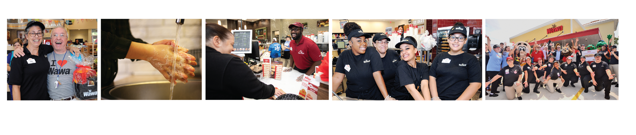

Wawa Food Safety Standards and Internal Audit
Caroline Friel
Regulatory Compliance Manager
Notes:
Welcome to Wawa’s Food Safety Awareness training.

Slide 2








Why Do We Need This?
Notes:
AMANDA GETTING AN UPDATED SLIDE.
This will be an animated slide. Have on the slide ‘Wawa BRAND TRUST” to start with, then bring in the each cog as indicated below when it is narrated.
(Bring in Increased Foodborne illness cog) If we are not consistently following our food safety standards and procedures it increases the likelihood that Wawa will have a foodborne illness outbreak. A foodborne illness outbreak would result in loss of trust from Wawa customers as well as:
(Bring in increased customer claim costs) Increased Customer Claims:
If customers becomes ill from our food Wawa would be expected to pay all medical costs and related expenses. The average claim costs of a single foodborne illness outbreak is estimated to cost $2 million dollars for approximately 250 people being impacted.
All of the above leads to:
(Bring in distraction from business goals) Distraction from Business Goals
The focus has been around building our Dinner, Catering and Delivery offers foodborne illnesses and claims distract us all from meeting these business goals.
(Bring in increased costs to wawa) Increased Costs to Wawa:
This could be related to additional cleaning & sanitation costs from using Lewis Environmental or additional store labor and supplies
Time and costs for managing and resolving the issues.
Fines and penalties by Regulatory agencies
(Bring in the final 3 cogs) Negative Publicity, reduction in customer count and possible closure of stores which will result in loss of jobs

Slide 3
How Food Safety & Safety is built into our Supply Chain & Store Processes
Product Development
Supplier Processes
Storage and Delivery to Stores
Equipment and Process Design
Food Safety is built in from the beginning in sourcing products for the stores
Wawa Product Development and Quality Assurance work together to review ingredients and build products with food safety as a top priority
1
Wawa Quality Assurance reviews product processes and conducts a Food Safety Audit at all potential supplier facilities before products are approved to be sold at Wawa
2
Wawa Supply Chain and Quality Assurance work together to ensure all third-party logistics partners are following food safety standards
3
Wawa Operations, Quality Assurance and Operations Engineering select and design the equipment and store processes to ensure proper temperatures, sanitation and safety
4
Food Safety must
continue in the stores through to the customer
Notes:
For the narration highlight the box that aligns with the text below.
Food Safety and Safety is built in from the beginning from when we source a product for our stores. (highlight 1) Wawa’s Product Development and Quality Assurance teams work together to review ingredients and products to ensure they are approved to be sold at a Wawa store. (highlight 2) This includes reviewing the supplier processes and conducting or reviewing food safety audits at the suppliers manufacturing locations.
(highlight 3) Once the product is approved the Wawa Supply Chain and Quality Assurance teams work together to ensure all third-party logistic partners such as McLane and Suneast are following food safety standards to keep our products safe and free from contamination.
(highlight 4) Lastly our Wawa Operations, Stores Operations Engineering and Quality Assurance teams work together to develop store processes and select equipment to ensure proper temperature control, sanitation and safety which is why it is critical that the product programs and job aids are followed as written to ensure we met regulatory requirements and serve consistently safe products to our customers.
Before we move on to highlight the Wawa Food Safety Standard’s let’s take a look at the type of food service products we use and the Health Department regulatory requirements to prevent contamination and foodborne illness.

Slide 4
Wawa Food Safety Standards Summary
Work Healthy &
Safe – Management Oversight
Keep it Clean & Organized Chemicals, Cleaning & Sanitation
Store Operations Food Safety Standards
Work Healthy &
Safe – Associate Health & Personal Hygiene
Keep it Clean & Organized Food Contamination Prevention
Keep it Cold & Hot – Food & Beverage Equipment
Keep it Clean & Organized Pest Management
All Information can be found on the MyWawa Food Safety HUB or FSRA Tool
Notes:
Wawa has Six Food Safety Standards which are designed to prevent biological, chemical and physical contamination to prevent foodborne illness or injury to our customers:
Work Healthy & Safe Management Oversight
Work Healthy & Safe Associate Health & Personal Hygiene.
Keep it Cold & Hot Food & Beverage Equipment.
Keep it Clean & Organized Chemicals, Cleaning & Sanitation
Keep it Clean & Organized Food Contamination Prevention
Keep it Clean & Organized Pest Management
The Wawa Food Safety standards are available on the MyWawa Food Safety HUB page or FSRA Tool. The standards are also built into our job aids and programs.
Over the next couple of slides, you will learn the critical controls within our standards that prevent foodborne illness or injury.

Slide 5
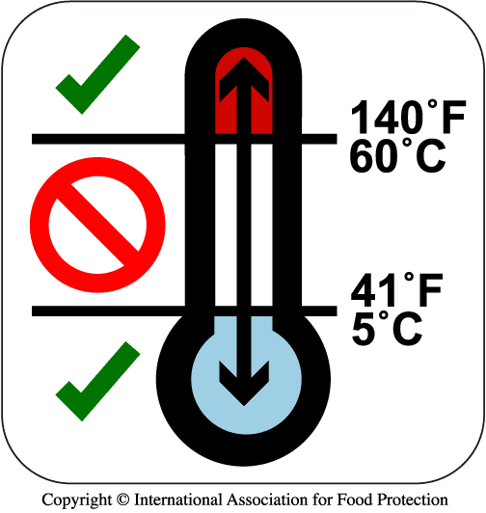

Food Safety Standards in our stores
How we prevent Foodborne Illness or Injury:
Wawa Approved Suppliers:
  Only use products from Wawa suppliers.
Keep it Cold & Hot:
  Keep Cold Foods at 41°F or below.
  Keep Hot Foods at 140°F or above.
  Only reheat/cook Foods following Wawa job aids:
    Ready-to-Eat 140°F
    Non-Ready to Eat 165°F (Hash Brown, Fries)
  Keep frozen products solid to the touch.
  Always follow the food donation storage requirements for refrigeration or freezing of products.
WHY: Wawa has Food Safety requirements for all suppliers and third–party logistic partners to reduce the risk of food being contaminated.
Temperature DANGER Zone
Limit TIME out of TEMPERATURE
WHY: Food must be kept out of the TEMPERATURE DANGER ZONE and not be TIME-TEMPERATURE abused to prevent the growth of bacteria
Notes:
Can we highlight the box being narrated.
(Highlight Wawa Approved supplier box) In order to prevent Foodborne Illness or Injury only use products from Wawa suppliers. Wawa has Food Safety requirements for all suppliers and third-party logistic partners to reduce the risk of food being contaminated.
(Highlight Keep it Cold & Hot section) Keep Cold Foods Cold and Hot Foods Hot. Wawa’s cold foods are kept at 41 degrees or below and Hot foods are kept at 140 degrees or above. Foods are reheated or cooked to the required temperatures in the Wawa equipment. Always follow the equipment programs and job aids to ensure foods are kept out of the temperature danger zone which is between 41 degrees and 140 degrees to prevent the growth of bacteria, that may cause foodborne illness.
Wawa’s eHACCP system monitors and records the critical food and equipment temperatures that helps keep our food safe.

Slide 6
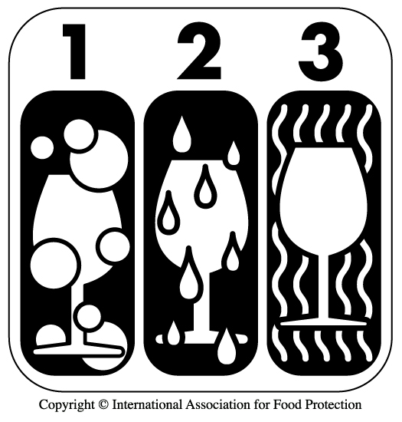

Food Safety Standards in our stores
How we prevent Foodborne Illness or Injury:
Keep it Clean & Organized:
  Food contact surfaces & utensils are washed, rinsed and sanitized every 4 hours.
  Sanitizer solution at 3 bay sink at correct concentration (150ppm to 400ppm).
  Refillable S&S Sanitizer buckets made correctly, and wipes used per job aids.
  Clean equipment per job aids.
Wash, Rinse & Sanitize
Prevent Cross- Contamination
WHY: Food and Food contact surfaces must be washed, rinsed & sanitized to remove contamination.
Food or Food Contact surfaces can become CROSS-CONTAMINATED when bacteria/viruses
are transferred from one surface/food to another.
Notes:
Keep it Clean & Organized. Food contact surfaces and utensils need to be washed, rinsed and sanitized to remove contamination and prevent the growth of bacteria that may cause foodborne illness. To learn more review the Wawa Food Contact Surface video available on the MyWawa Food Safety Hub page.
The sanitizer solution at the 3 bay sink and refillable sanitizer buckets must be filled using the correct sanitizer dispenser and made according to the job aids to ensure the food contact surfaces are sanitized to remove contamination, prevent cross contamination and again prevent the growth of bacteria that may cause foodborne illness.

Slide 7

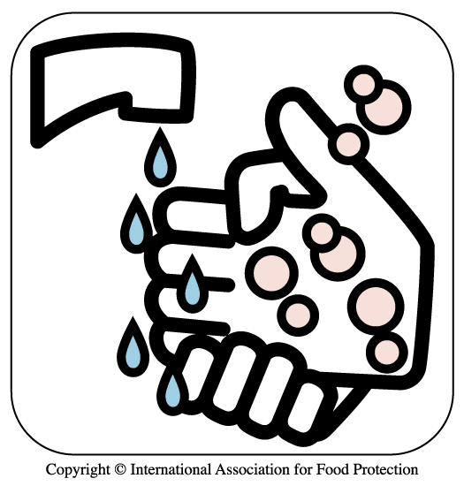
Food Safety Standards in our stores
How we prevent Foodborne Illness or Injury:
Work Healthy & Safe:
  Do not come to work when sick.
  Complete the Annual Associate Health Agreement and refer to Reflexis (time clock) Associate Health timecard to stay up-to-date with reportable illnesses & symptoms that must be reported to the MOD.
  Ensure all wounds are covered on hands and wrist.
  Wash hands correctly and wear foodservice gloves when handling food and food contact surfaces:
    For Non-Ready to Eat Foods (Hash Browns & Fries) wash hands and change gloves after handling. Option to use a quick sheet to limit handling.
    Use utensils per job aids to limit handling of foods.
WHY: Food can become contaminated if you come to work sick. Hands must be washed after using
the restroom and prior to starting foodservice tasks to prevent food & surfaces from
becoming contaminated.
Notes:
Work Healthy & Safe. Do not come to work when sick, as food can become contaminated and cause foodborne illness. Refer to the Annual Associate Health Agreement in Workday, Reflexis time clock questions and Associate Health laminated card near the time clock to stay up-to-date with the reportable illnesses and symptoms that must be reported to the Manager on Duty prior to coming to work.
Once at work ensure all wounds are covered on hands and wrists prior to working and always wash hands and wear foodservice gloves when handling food and food contact surfaces. Most products in our foodservice areas are ready to eat for example produce, deli meats or frozen snacks, this means that after directly handling the product food service gloves do not need to be changed and hands washed prior to putting on clean gloves.
Wawa does have a couple of non-ready to eat frozen products for example Hash Browns and Fries that do however require a glove change/hand wash if handled PRIOR to cooking. Always refer to job aids that provide the glove changes/handwash requirements and which utensils or quick sheet can be used to limit handling.
Watch the Wawa Handwashing video that shows how to wash your hands correctly to prevent our food and surfaces from becoming contaminated.

Slide 8
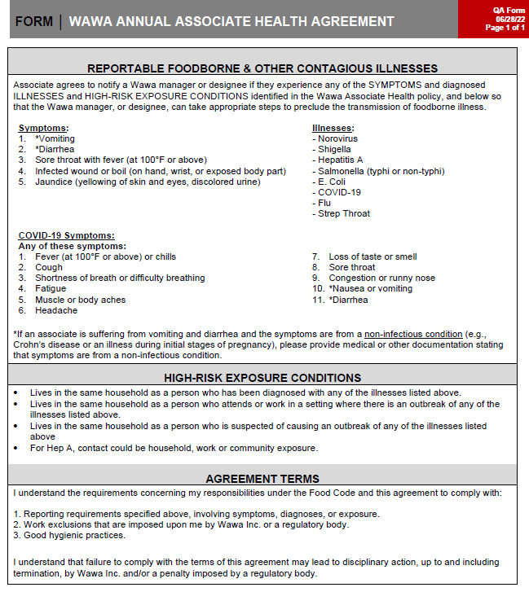
Associate Health Agreement
Associates agree to notify their MOD if they experience:
  Any symptoms consistent with a contagious illness
  Contagious illnesses that require work restrictions per the FDA Food Code, health department, or a medical doctor
  High-risk exposures to contagious illnesses that require work restrictions per the FDA Food Code, health department, or medical doctor
Associates are required to sign this agreement upon hire and annually

Slide 9
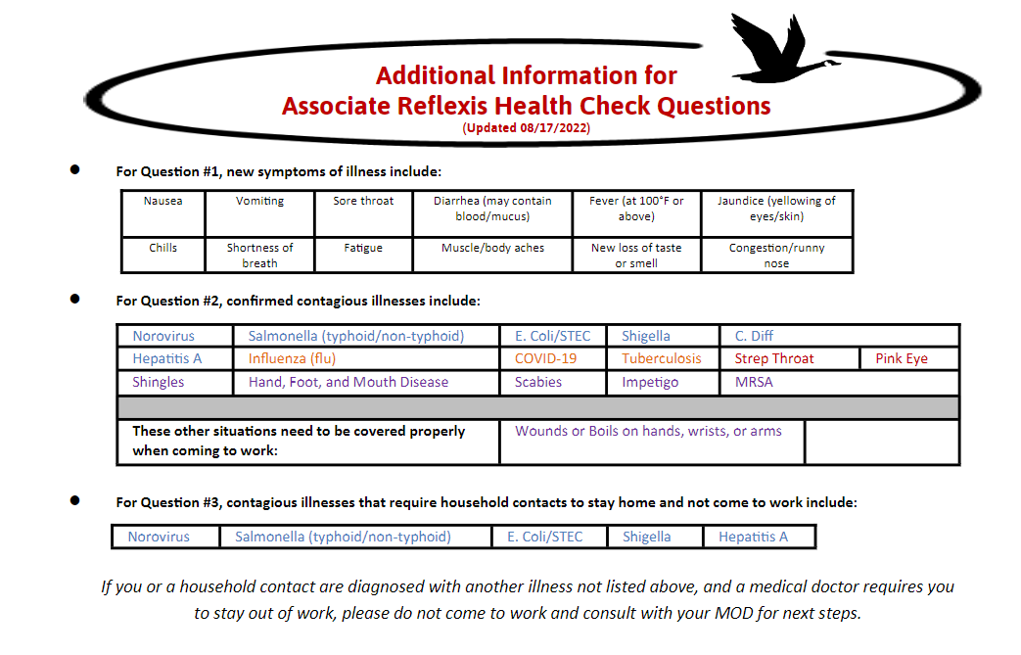
Reflexis Daily Health Check
Associates will complete their daily Health Check in Reflexis when they clock in for their shift.
The Health Questions include:
  Do you have any new symptoms of illness?
  Do you have a confirmed contagious illness?
  Does someone at home have a contagious illness?
If an associate answers ‘Yes’ to any of the questions, they must inform the MOD that they are unable to clock-in.
Use the Illness Exclusion Criteria Cheat Sheet on the Associate Health Resources page to assist you in providing the correct information to your associate

Slide 10
Food Safety and Risk Audit
Total Wawa stores now 1000
( PA, NJ, DE, MD, VA, FL and Washington DC) . New markets within the next 7 years will double store count to include – AL, NC, GA, TN, OH, IN, KY
Audit performed 3x a year by Wawa Quality Assurance Field Specialists and a third party food safety audit company
Audit mirrors the FDA Food Code but more stringent with additional Wawa standards including workplace safety
Auditors use an I pad send results to store and live dashboard for information every day

Slide 11
Food Safety and Risk Audit
Stores receive a score weighted by critical line items
A scorecard is shared monthly with the Operations team calling out trends and areas that need improvement
Stores that fail receive coaching and training then a re audit , QA team partners closely with Operations team

Slide 12
Calibration
Line item citation report
Shadowing /reverse shadowing
Training with third party trainer classroom and field
End of audit round quiz and meeting
Audit performed with same flow, start and finish

Slide 13
Food Safety & Safety Vision
To maintain the 100+ years of trust in our Brand by providing a safe working and shopping environment and serving safe, quality food every day.
Leaders are expected to drive food safety and safety behaviors throughout store operations to maintain the vision and customer trust
Notes:
You should now have an understanding of how food can become contaminated and cause a foodborne illness or injury AND how Wawa has built Food Safety & Safety into the products we buy from our suppliers, right through until the products are sold to our customers.
All the Wawa Programs, Food Safety Standards, and Job Aids are designed to met regulatory requirements and maintain the 100 plus years of trust in our Brand by providing a safe working, and shopping environment and serving safe, quality food every day which equals ‘GooseTrust’ for our associates and customers.
Leaders in our Stores are expected to drive key food safety & safety behaviors throughout there stores to met regulatory requirements and maintain customer trust and ensure safe, quality food is served every day.

Slide 14



Key Leadership Food Safety & Safety Behaviors
1) Use analytics and reports to discuss and mitigate risks.
2) Know where to find information on the Food Safety & Safety HUB page /FSRA Tool and explain the ‘Why’.
3) Identify your stores most frequently asked questions to ensure Standards are understood and executed.
4) Model the Way. Model the Standards.
5) Hold yourself and others accountable for mitigating risks.
6) Connect with stores during peak times/promotions to ensure things are done right.
7) Always be aware of your surroundings.
8) Coach Associates to learn and improve self-assessment results.
9) Identify self-assessment items that need further assistance. Escalate for additional support.
Notes:
Leaders in our Stores are expected to drive key food safety & safety behaviors throughout there stores to met regulatory requirements, maintain customer trust and ensure safe, quality food is served every day.
There are three key behaviors:
Communication:
Use reports such as the Monthly FSRA scorecard and store specific FSRA report when discussing food safety and safety performance with your teams.
Know where to find the food safety and safety information on the MyWawa Food Safety & Safety HUB page or FSRA Tool. Understand what the standards are and why they are important.
Teamwork:
Your team watches how you behavior in your store, it is therefore important to Model the Way. This starts with personal hygiene – not coming to work when sick, washing hands and wearing gloves when handling food or food contact surfaces.
If you see food safety behaviors that need addressing use the coaching model (L&D please advise on what the coaching model is) to address so your store is consistently following the food safety standards.
Check in with stores during peak times and promotions to make sure things are done right and always be aware of your surroundings
Continuous Improvement:
Use the food safety self-assessment checklists on the MyWawa Food Safety HUB page or FSRA Tool. These checklists are a good resource to help your team maintain food safety standards and improve performance throughout your store.
If there are self-assessment items, you and your team can not resolve escalate to your Manager for additional support or contact QA.

Slide 15

Regulatory Compliance
Partnership is Paramount
Internal Key Partners – Facilities, Store Operations, Construction, Marketing, Community Cares, Learning and Development, People Team, Government Relations and Marketing
External Key Partners – State and Local Health Departments, Industry and Academia
Notes:
Key Partners include Facilities for things like pest control, water quality and sewage
Construction team for opening of new stores, especially in new markets
Community cares for special events (hoagie day for example) and licensing of our mobile beverage units
Marketing on new initiatives like pizza
Partnership is the key to building a strong food safety culture

Slide 16
Continue the
100+ Years
of Trust in
Our Brand
Thank You!

Slide 17

QUESTIONS AND ANSWERS

